Slide 1
Java Class
Day 13

Slide 2





Jul
Aug
TOEIC(7/24) 6/6~7/11
TEPS(7/16) 6/29~7/12
TOEIC(8/07) 6/20~7/25
TOEIC(8/21) 7/ 4 ~ 8/ 8
TEPS (8/06) 6/20~7/17
TEPS (8/20) 7/ 4 ~7/31
Big Data Analyst(10/1)
8/29~9/2
ADsP(8.28) 8/1~8/5
www.toeic.co.kr
www.teps.or.kr
www.dataq.or.kr
austin.sogang.ac.kr
austiny.snu.ac.kr

Slide 3
Mon
Tue
Wed
Thu
1. Main
Fri
1. Recap Sub
2. Main
2.
3. Main
3.
4. Main
4.
LUNCH
LUNCH
5. Sub
5. Recap Main
6. Sub
6.
7. Sub
7.
8. Recap, Test
8. Test
Jul
Aug
Java Basic
HTML, CSS, JS
Java Intermediate
Database

Slide 4
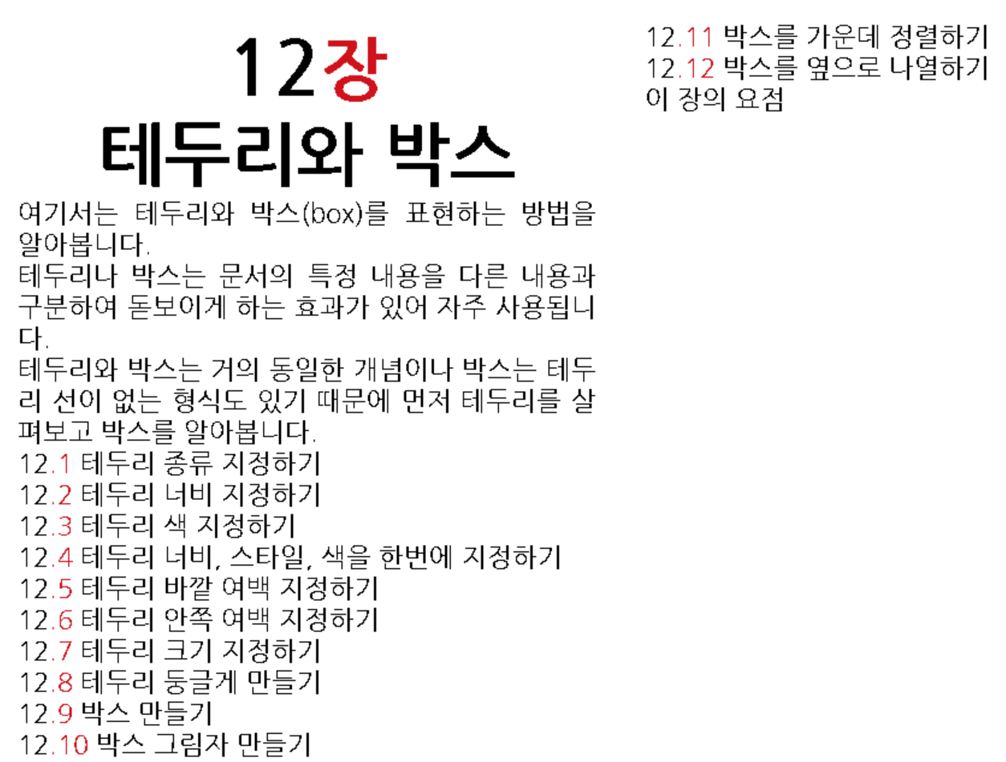
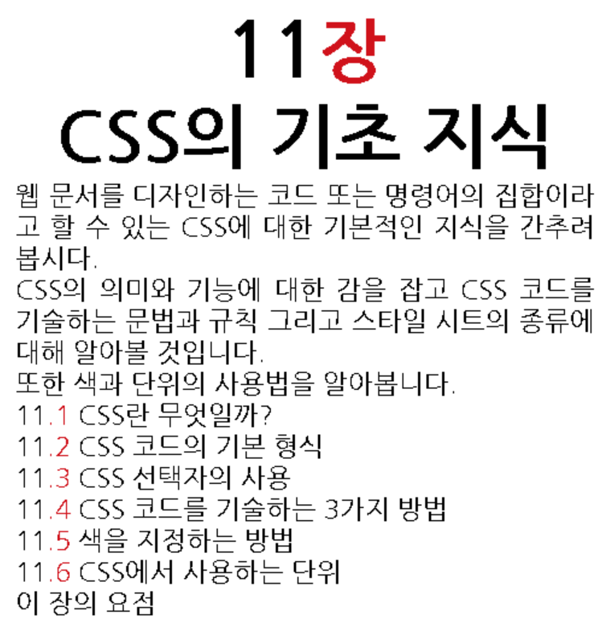
CSS

Slide 5
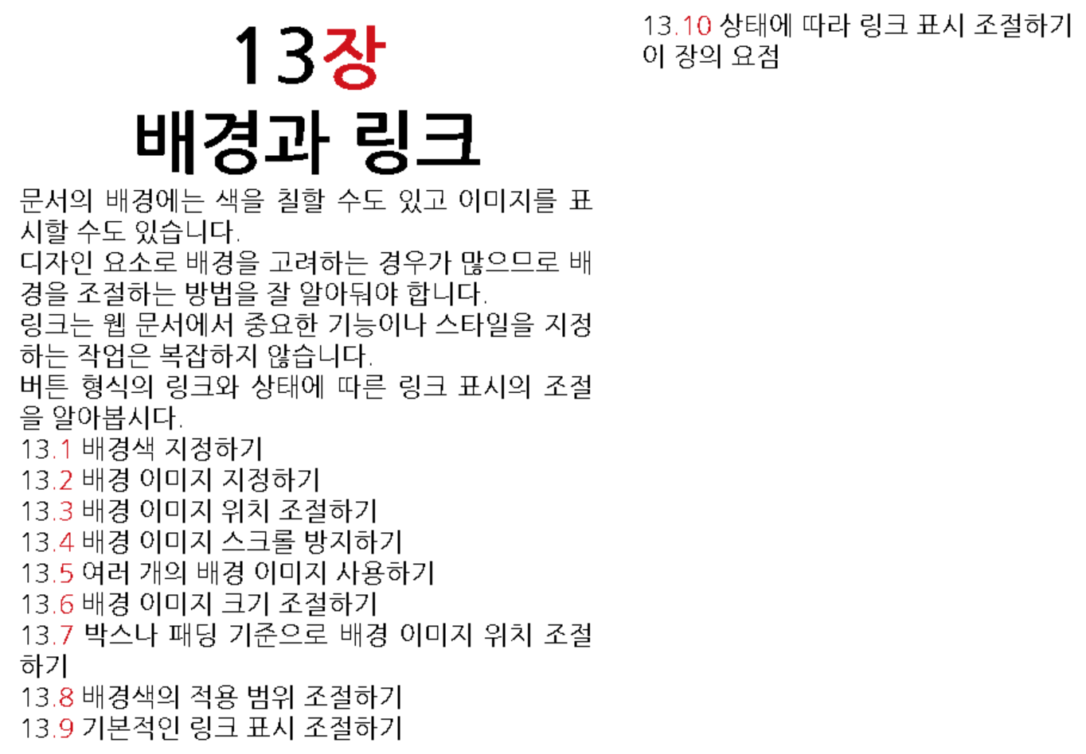
CSS

Slide 6
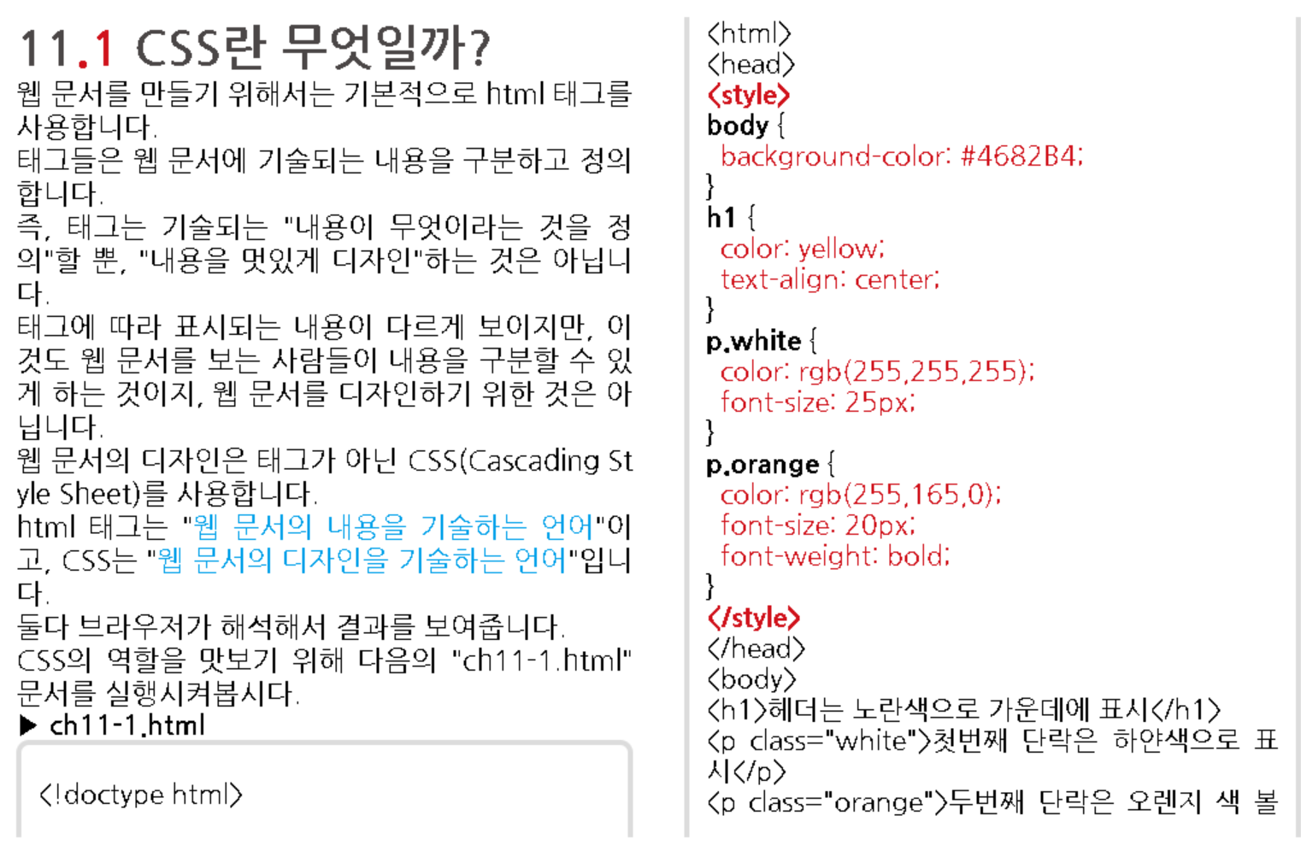

Slide 7
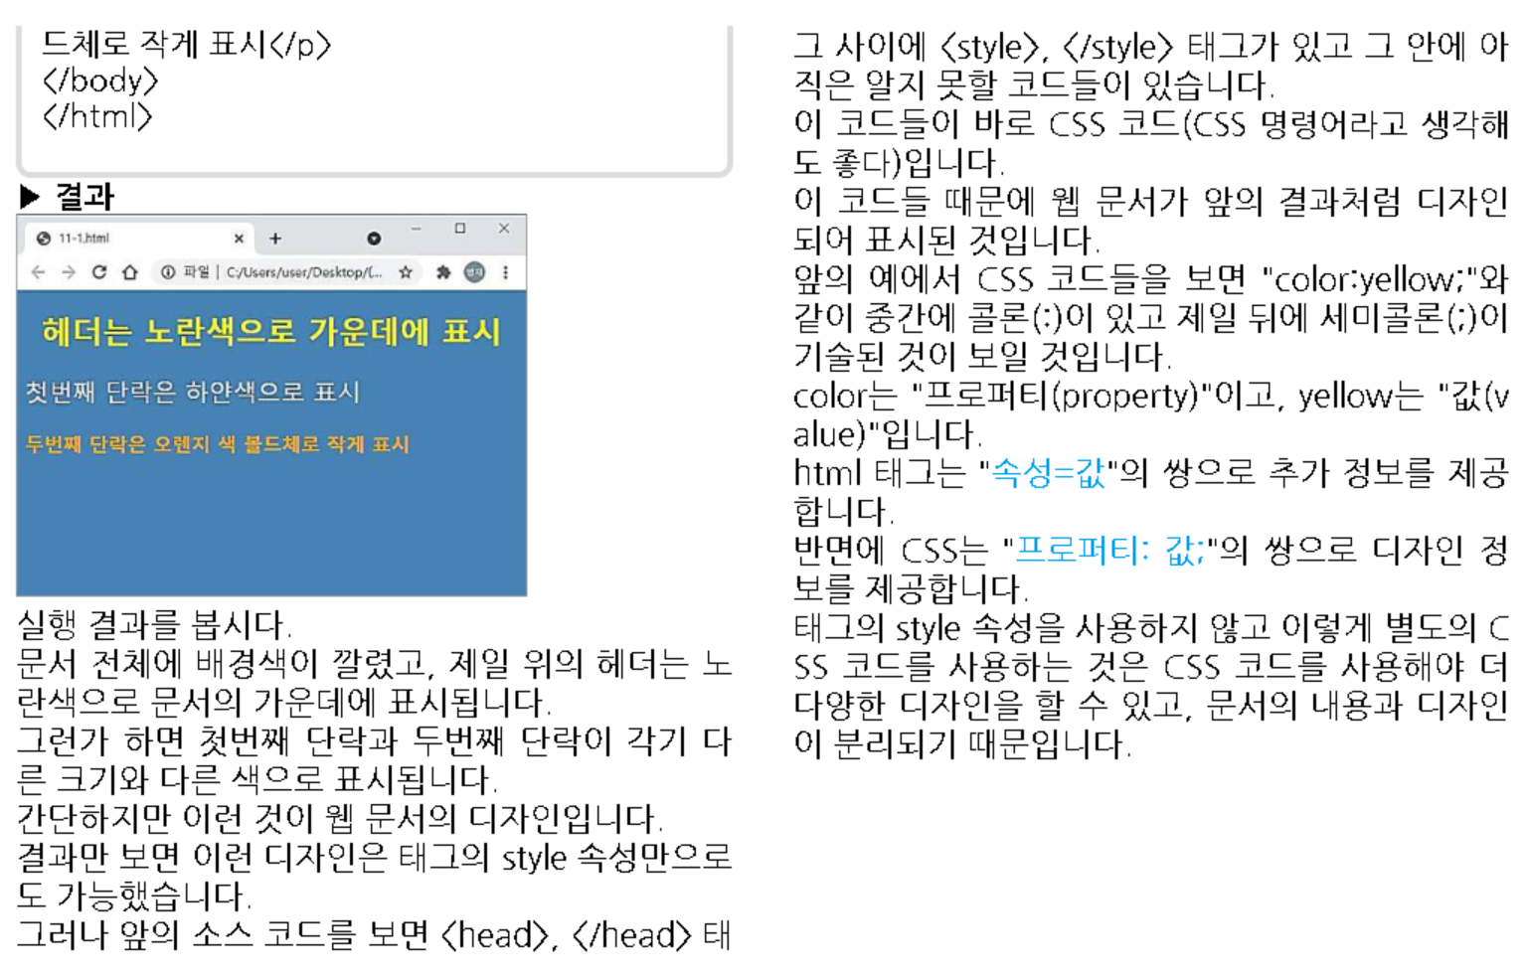

Slide 8
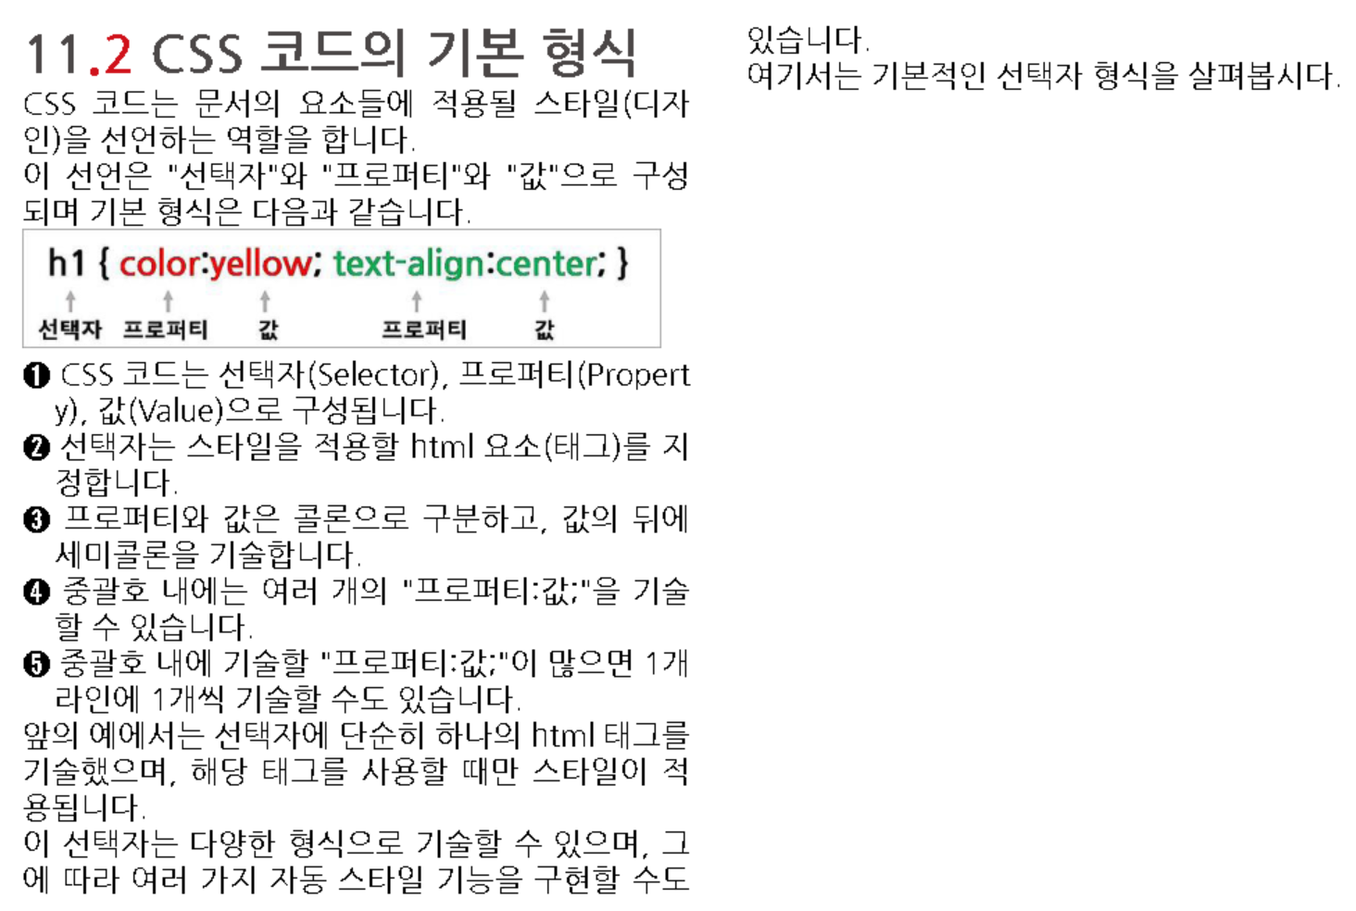

Slide 9
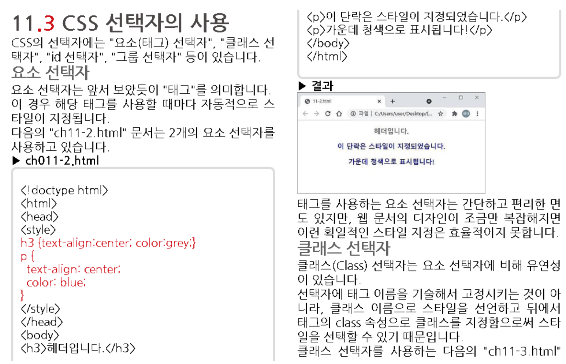

Slide 10
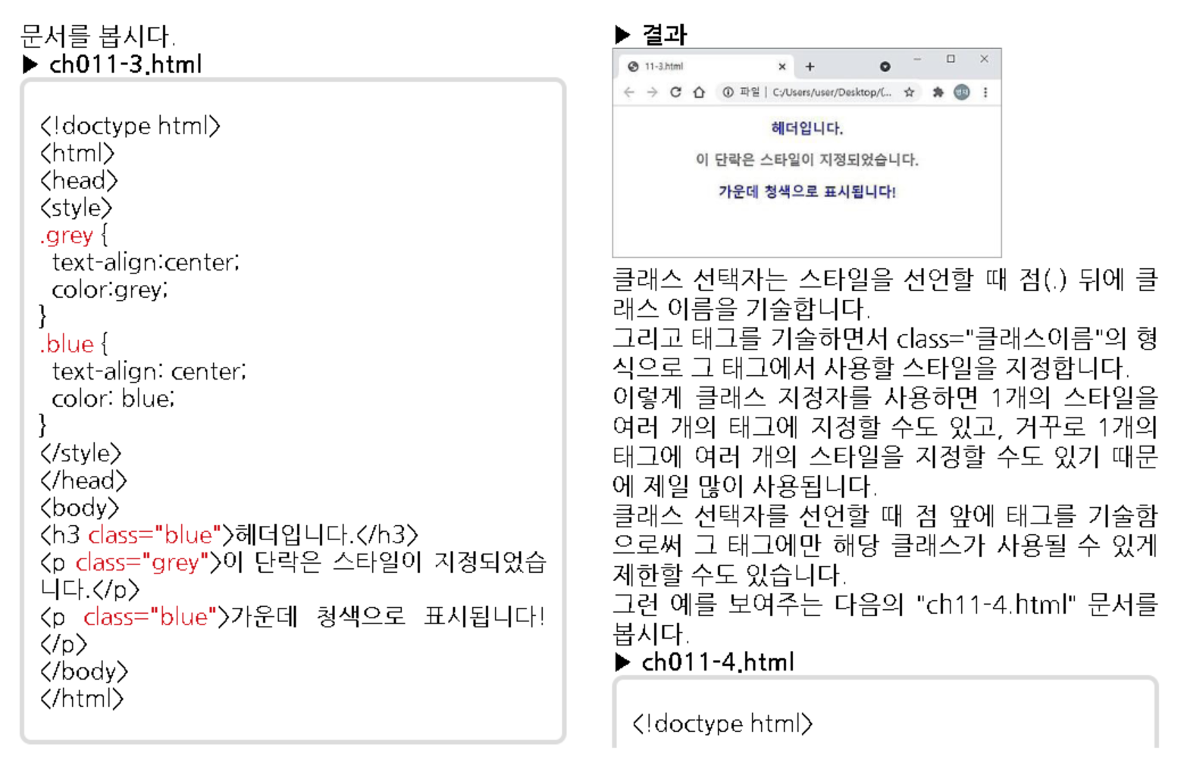

Slide 11
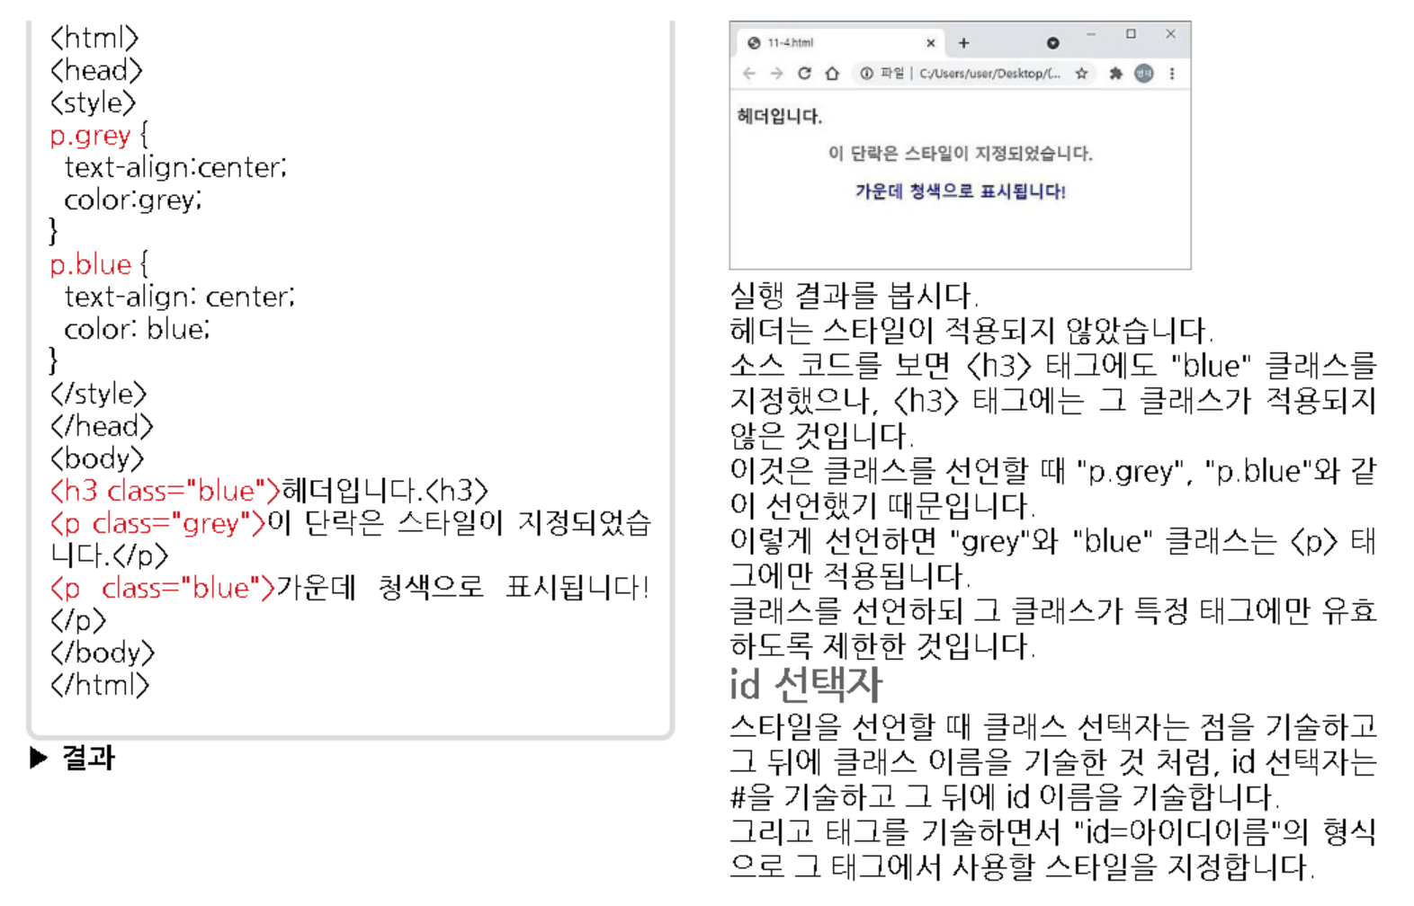

Slide 12
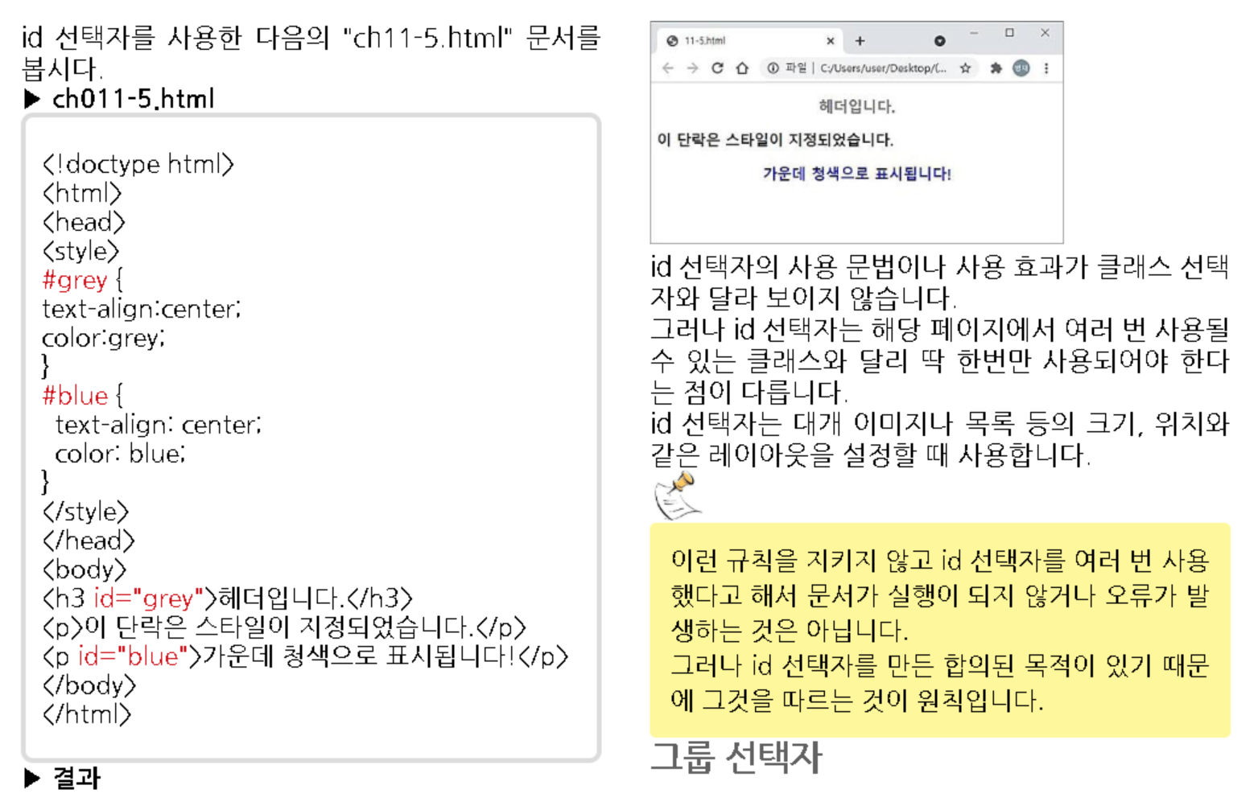

Slide 13
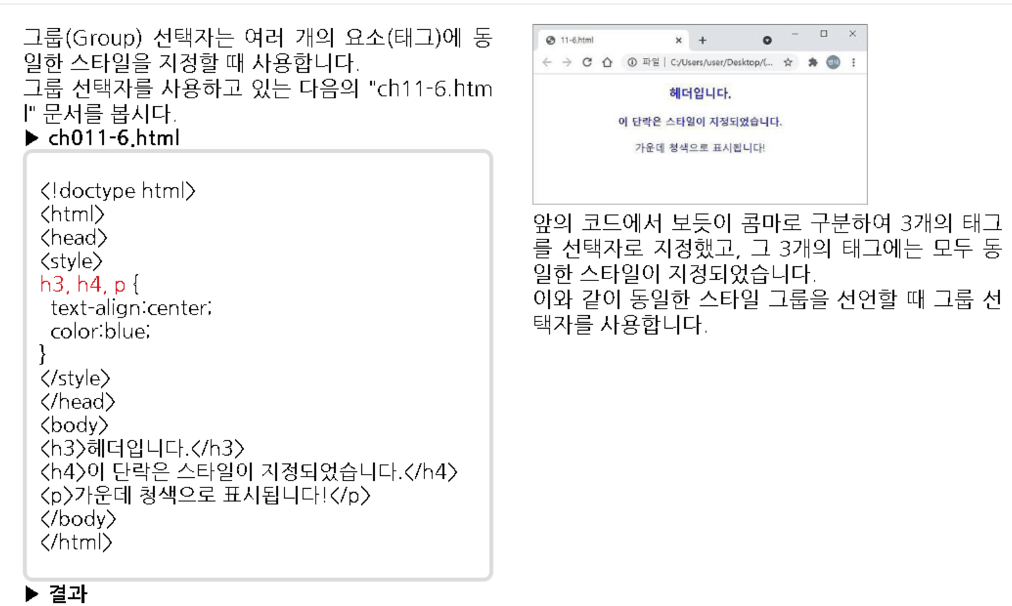

Slide 14
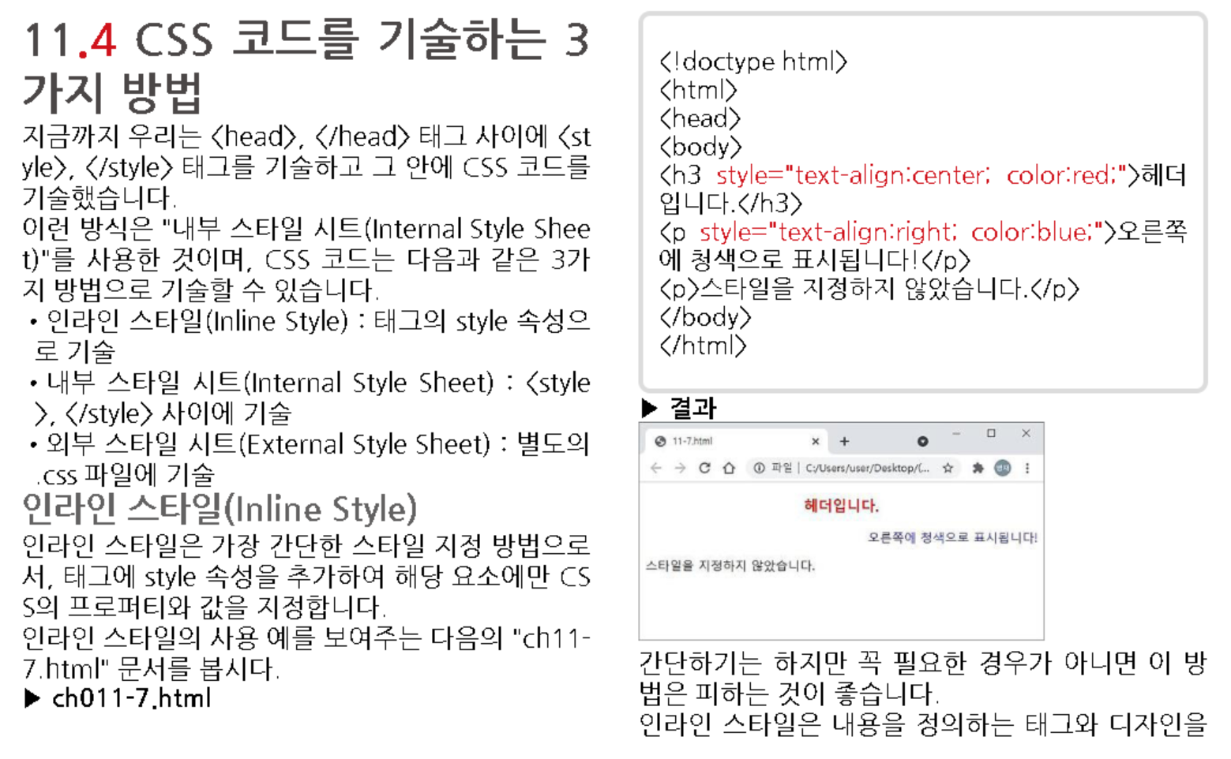

Slide 15
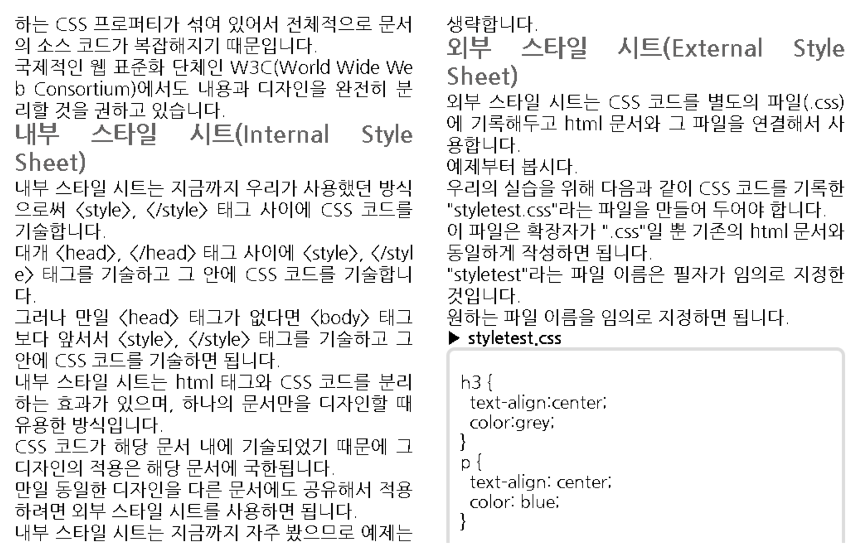

Slide 16
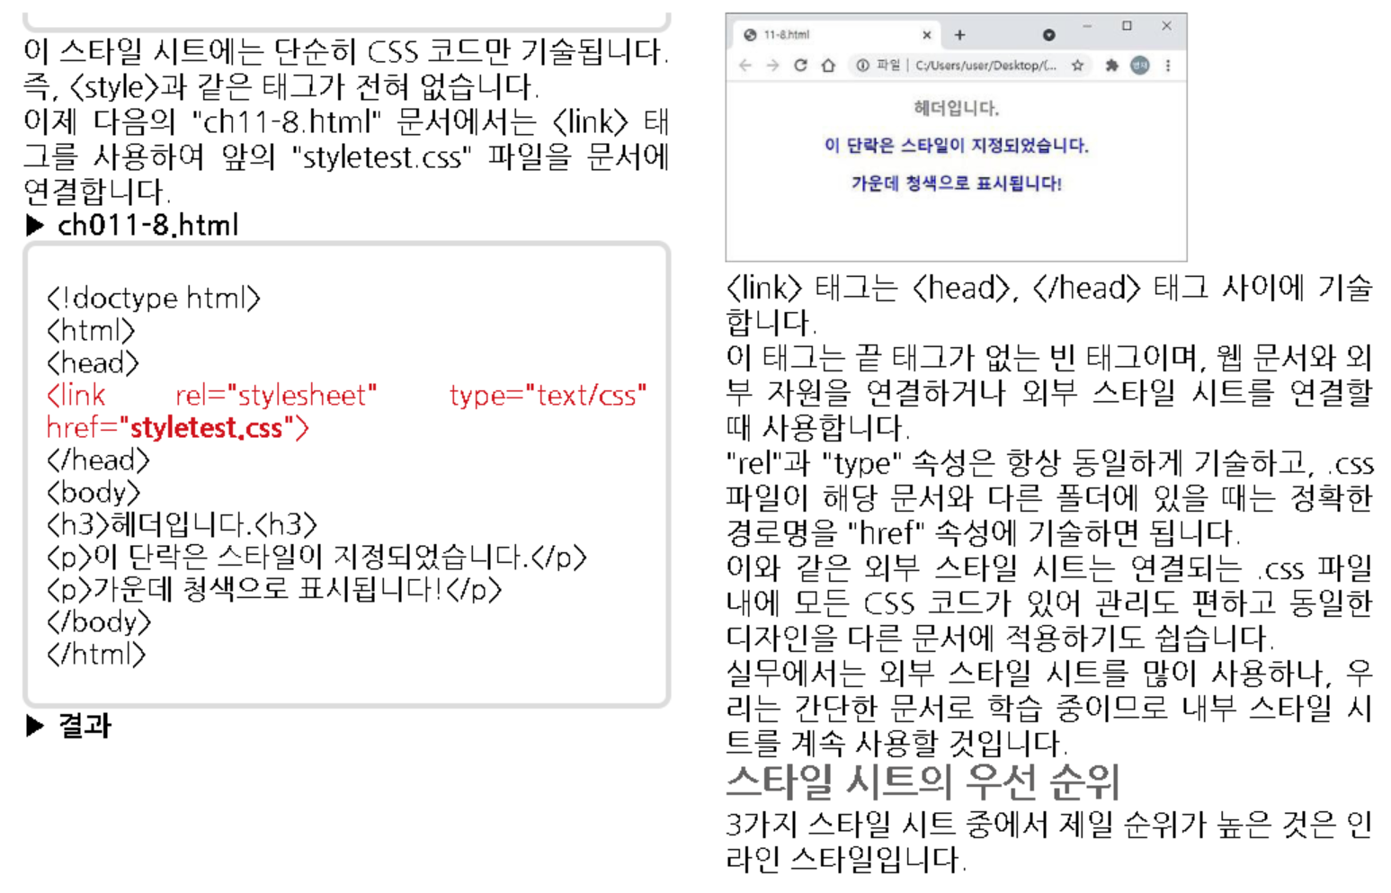

Slide 17
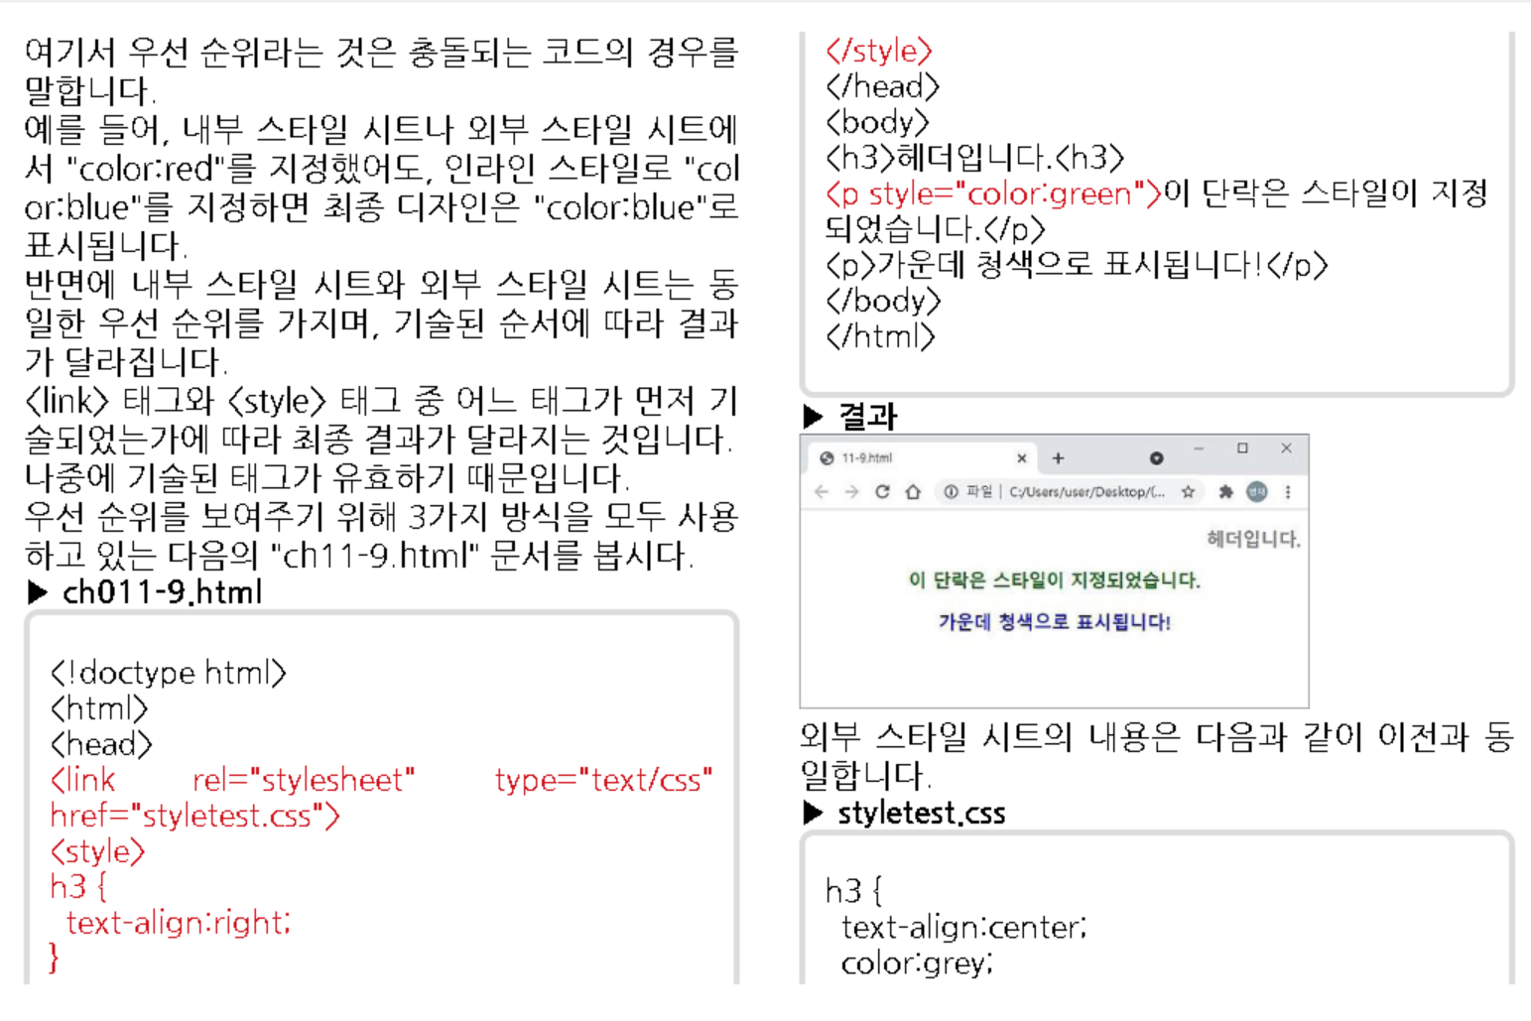

Slide 18
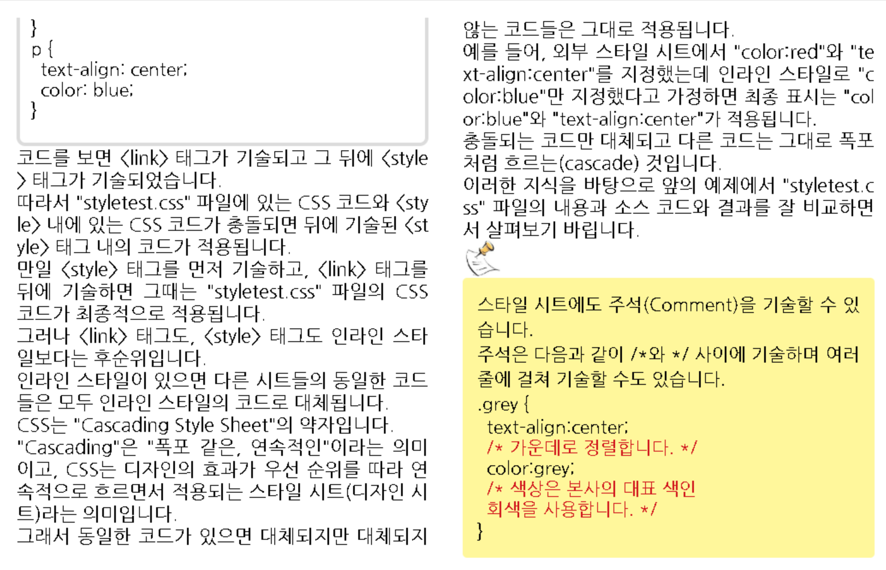

Slide 19
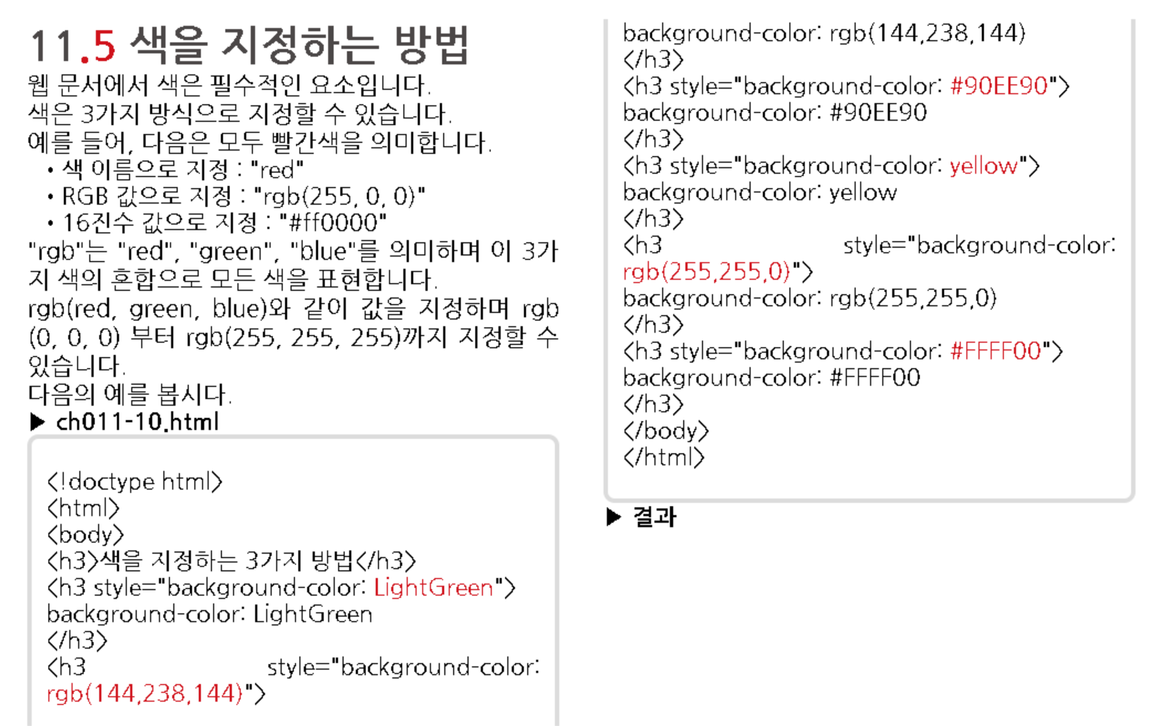

Slide 20
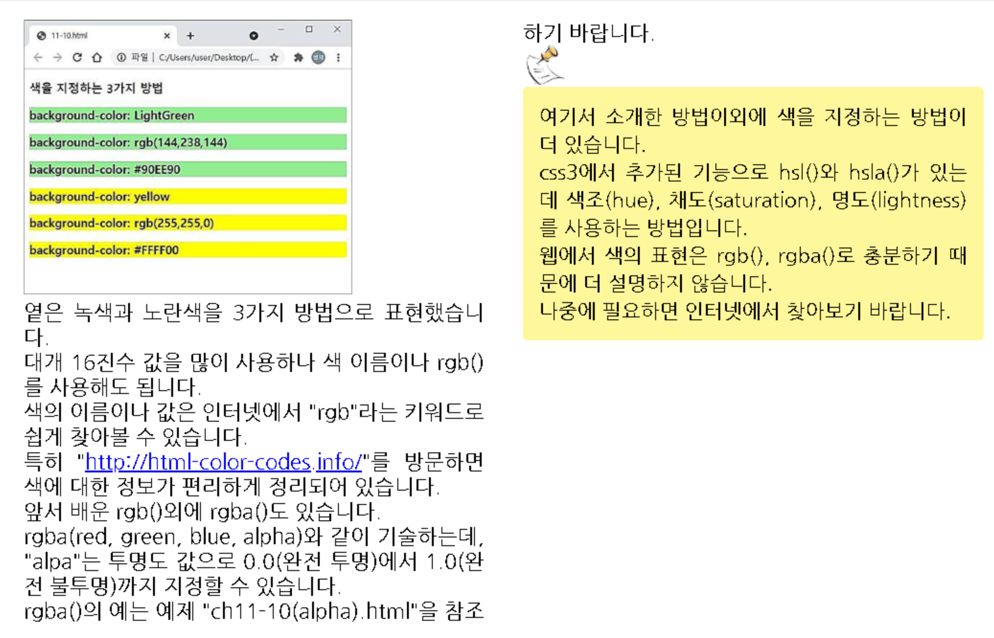

Slide 21
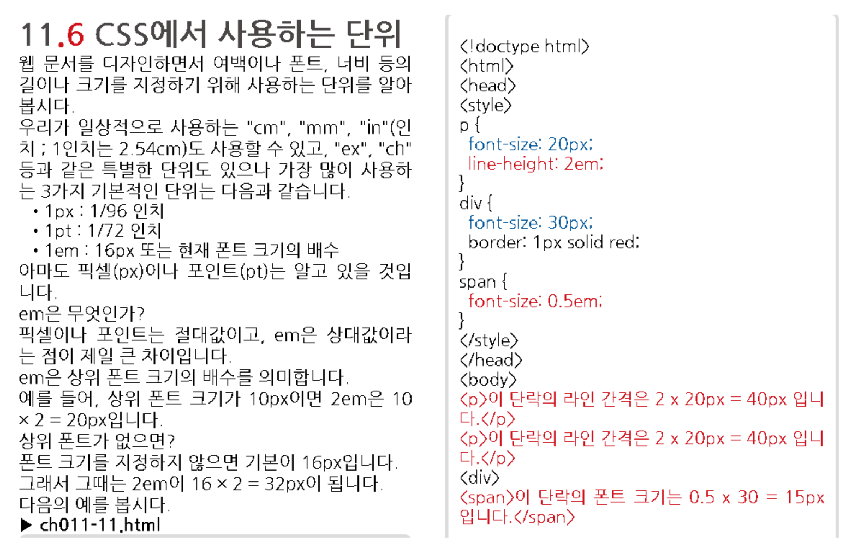

Slide 22
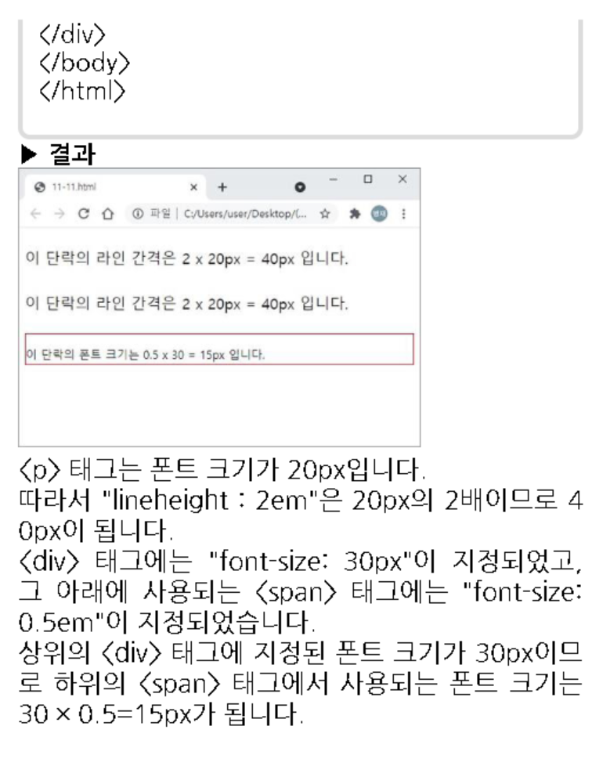

Slide 23
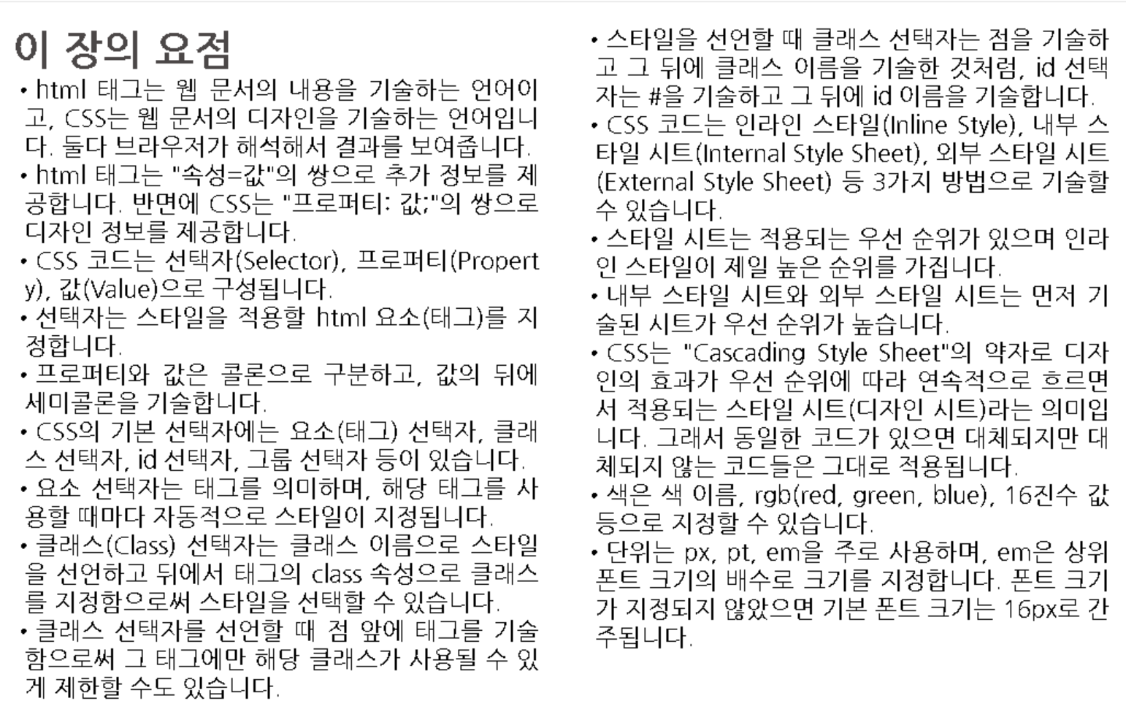

Slide 25
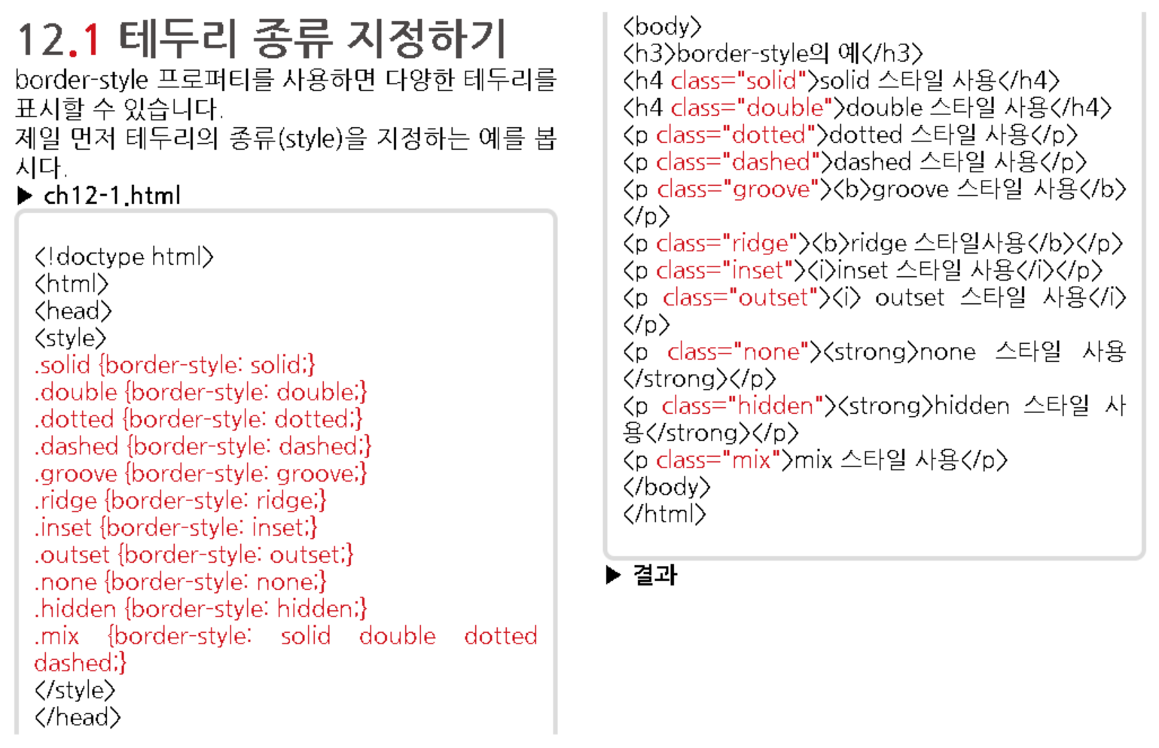

Slide 26
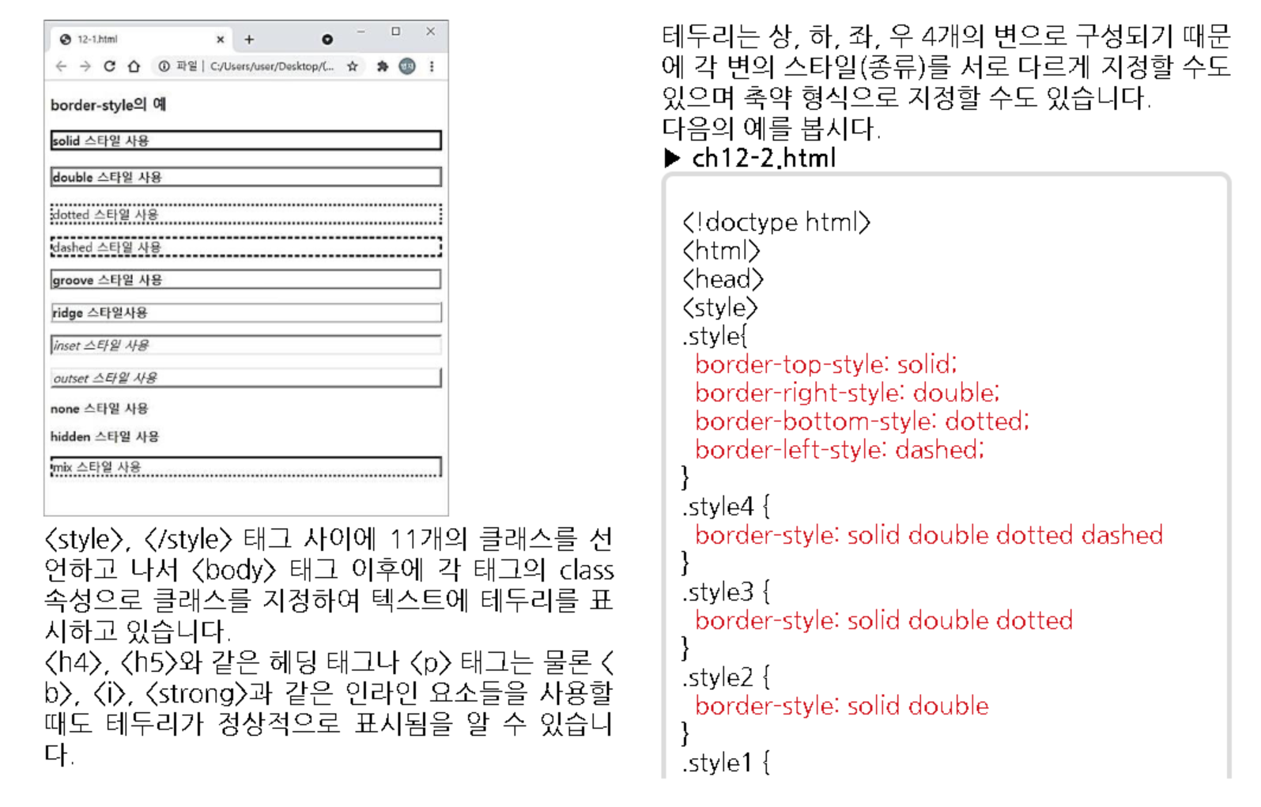

Slide 27
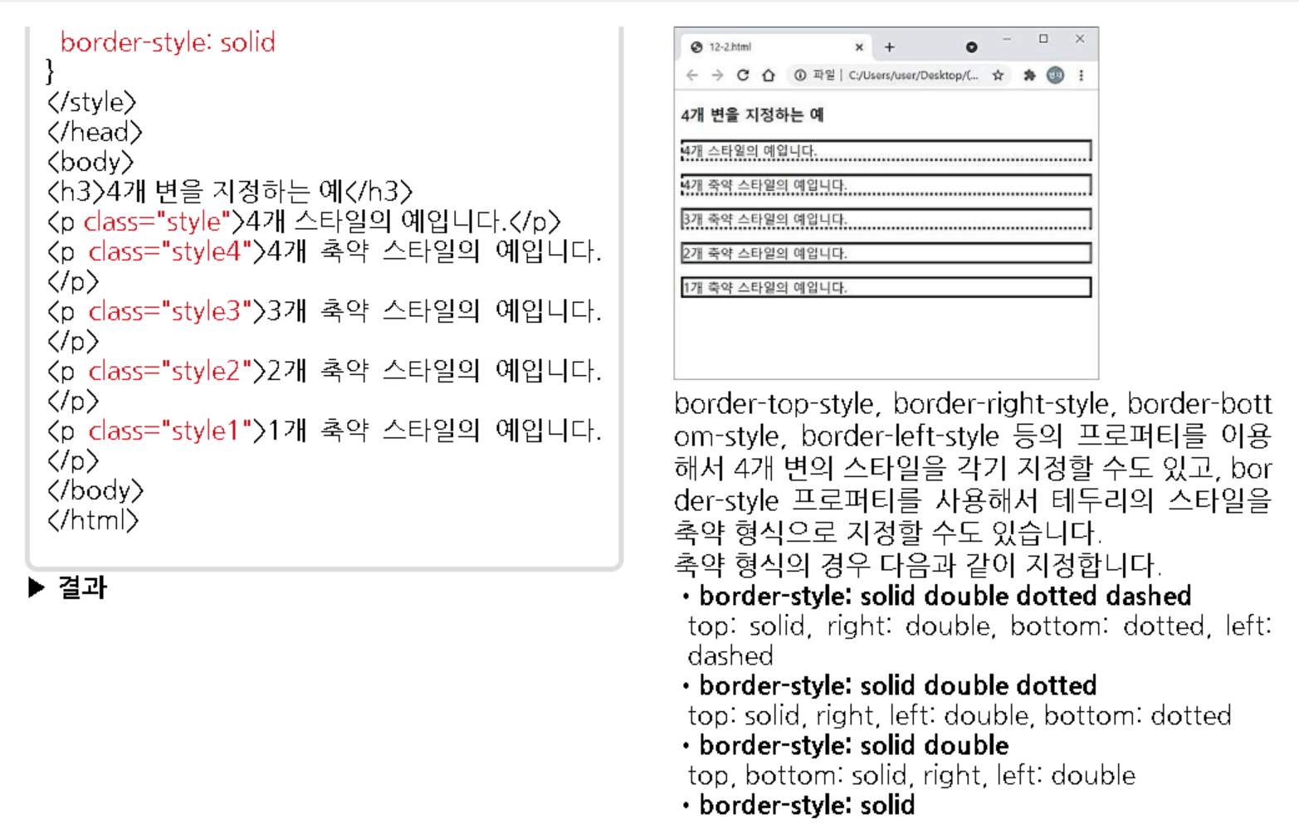

Slide 28
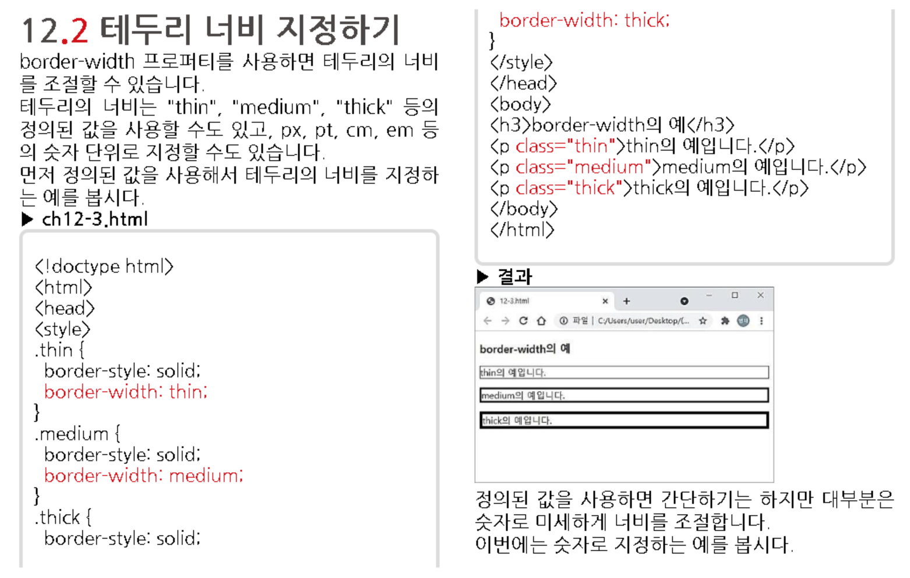

Slide 29
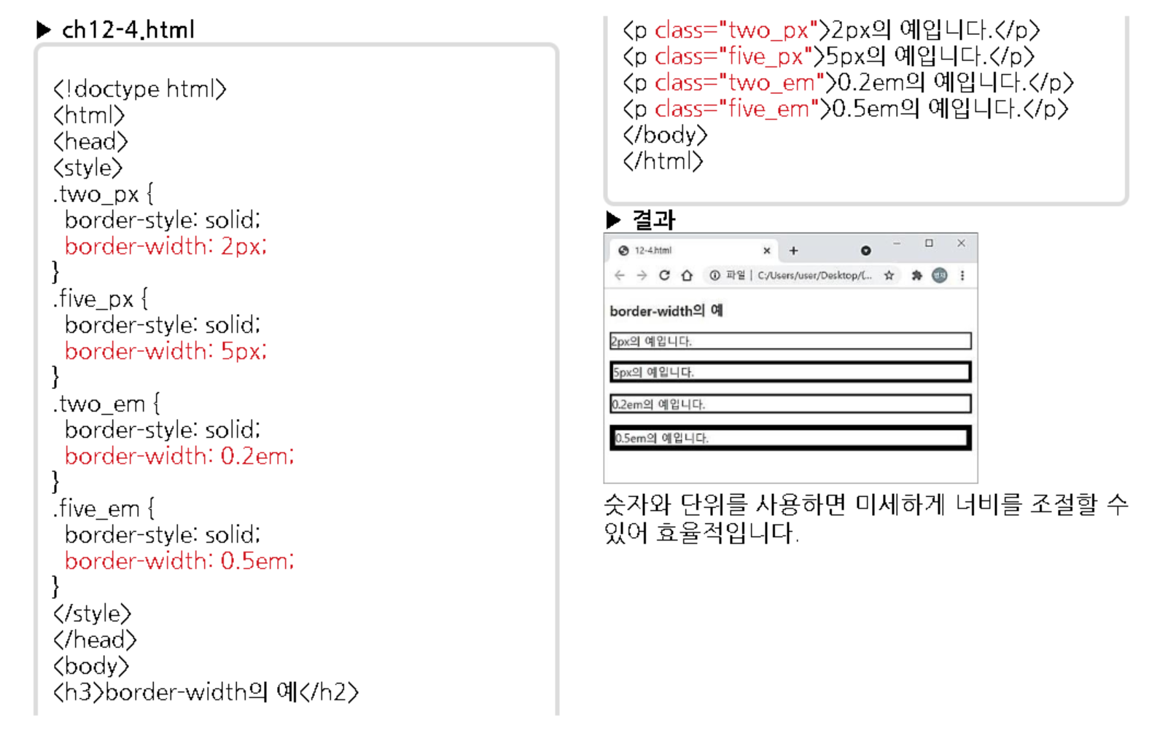

Slide 30
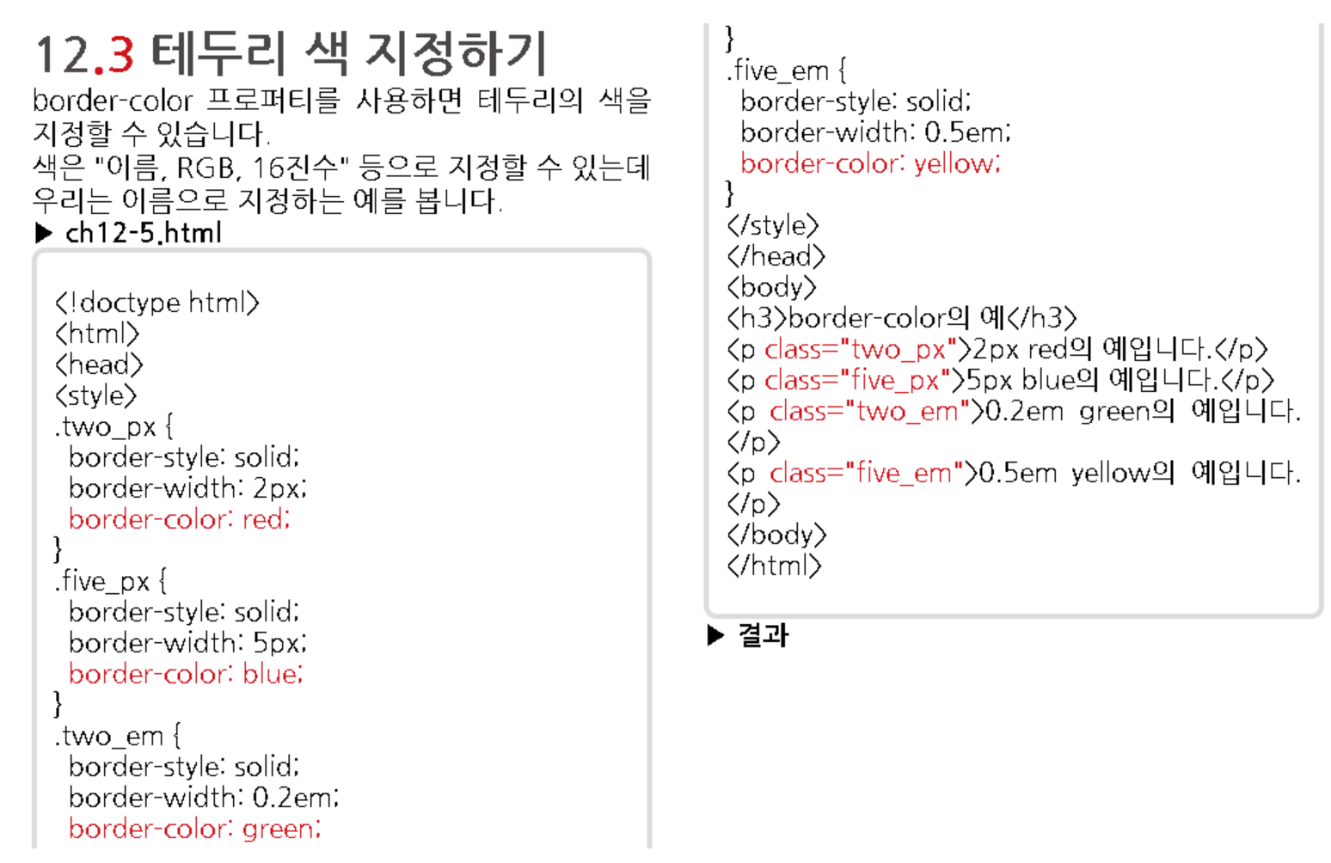
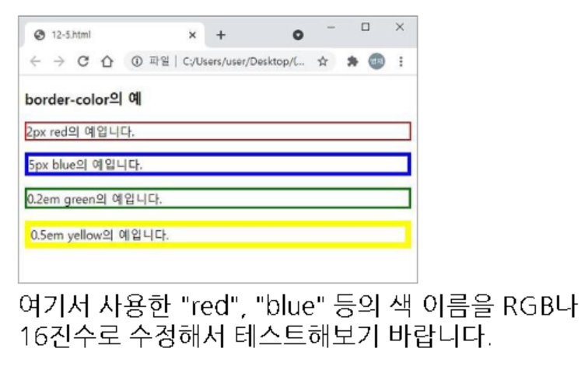

Slide 31
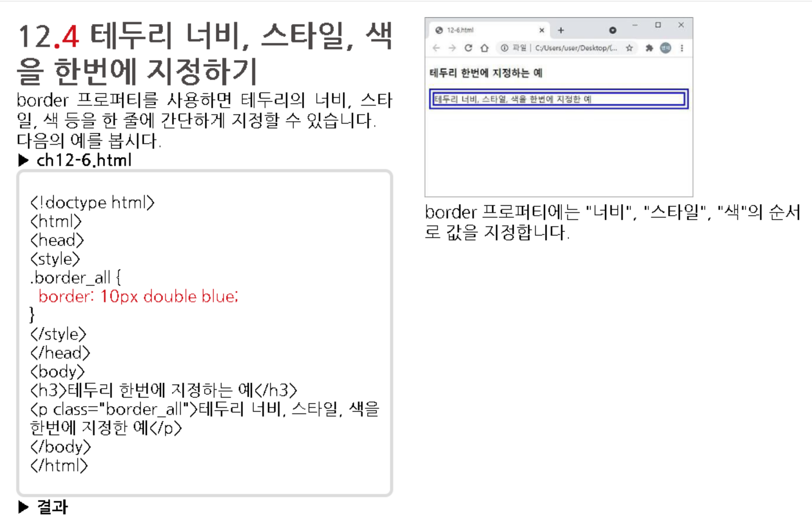

Slide 32
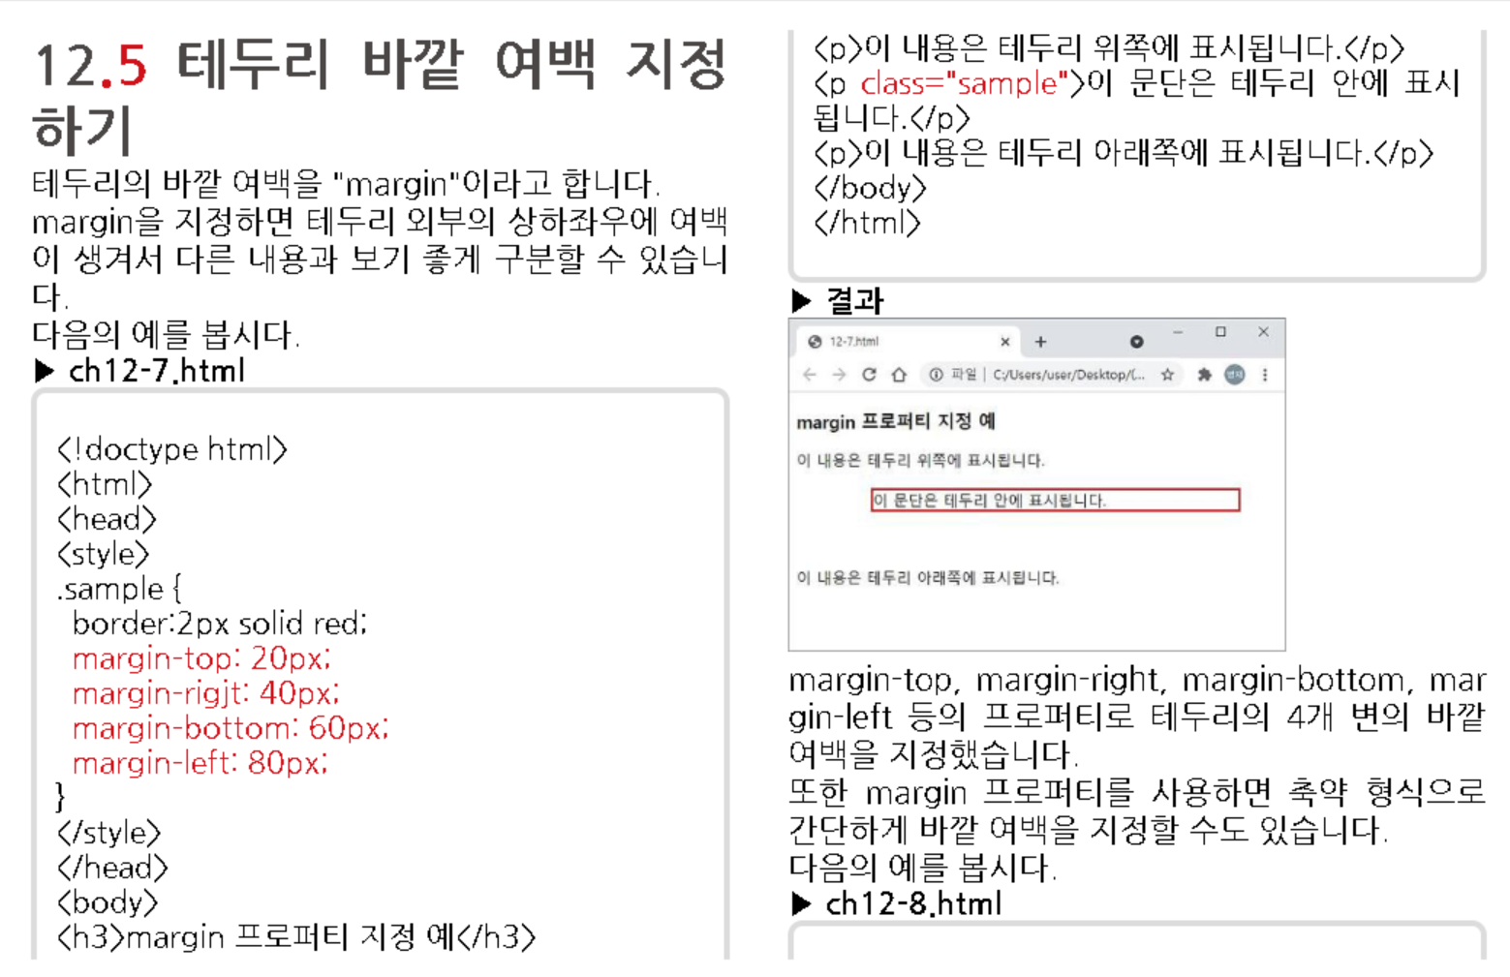

Slide 33
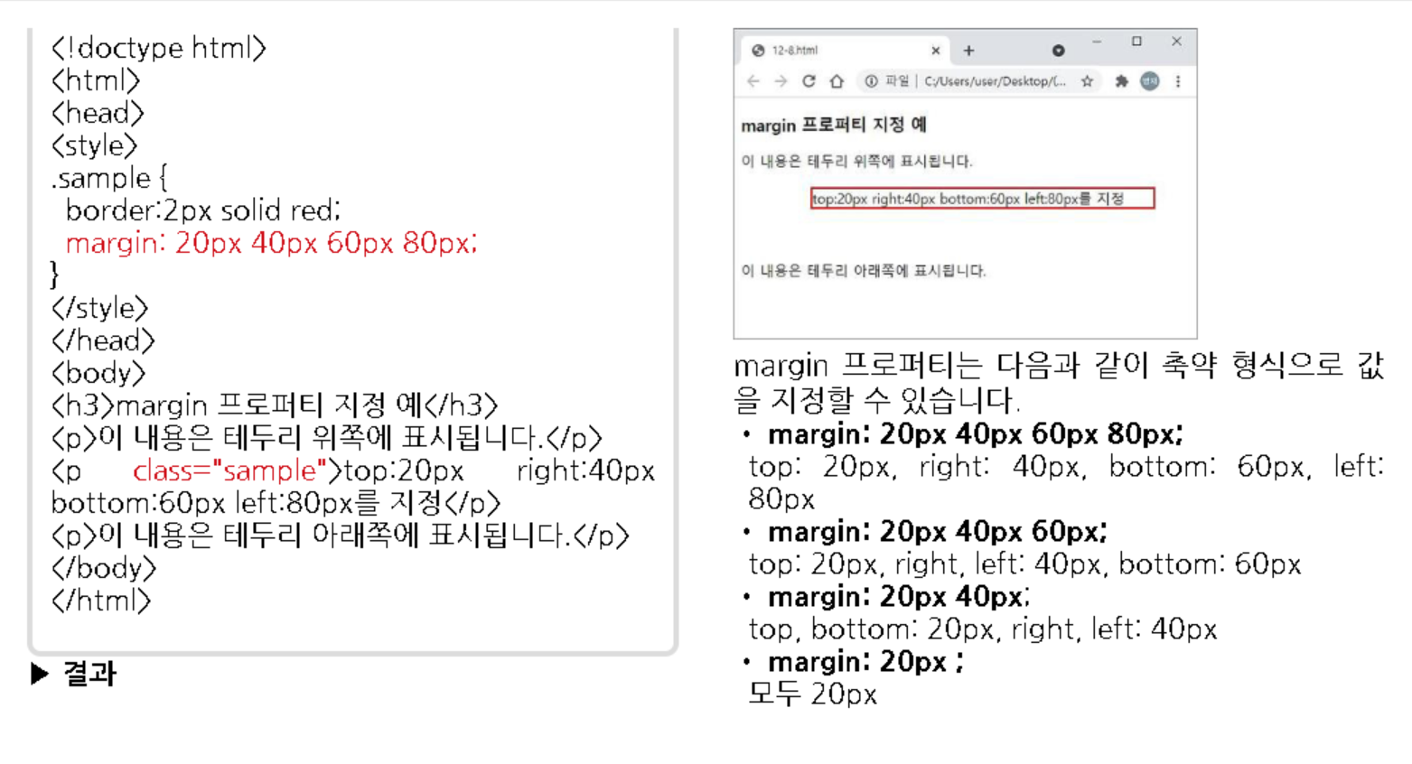

Slide 34
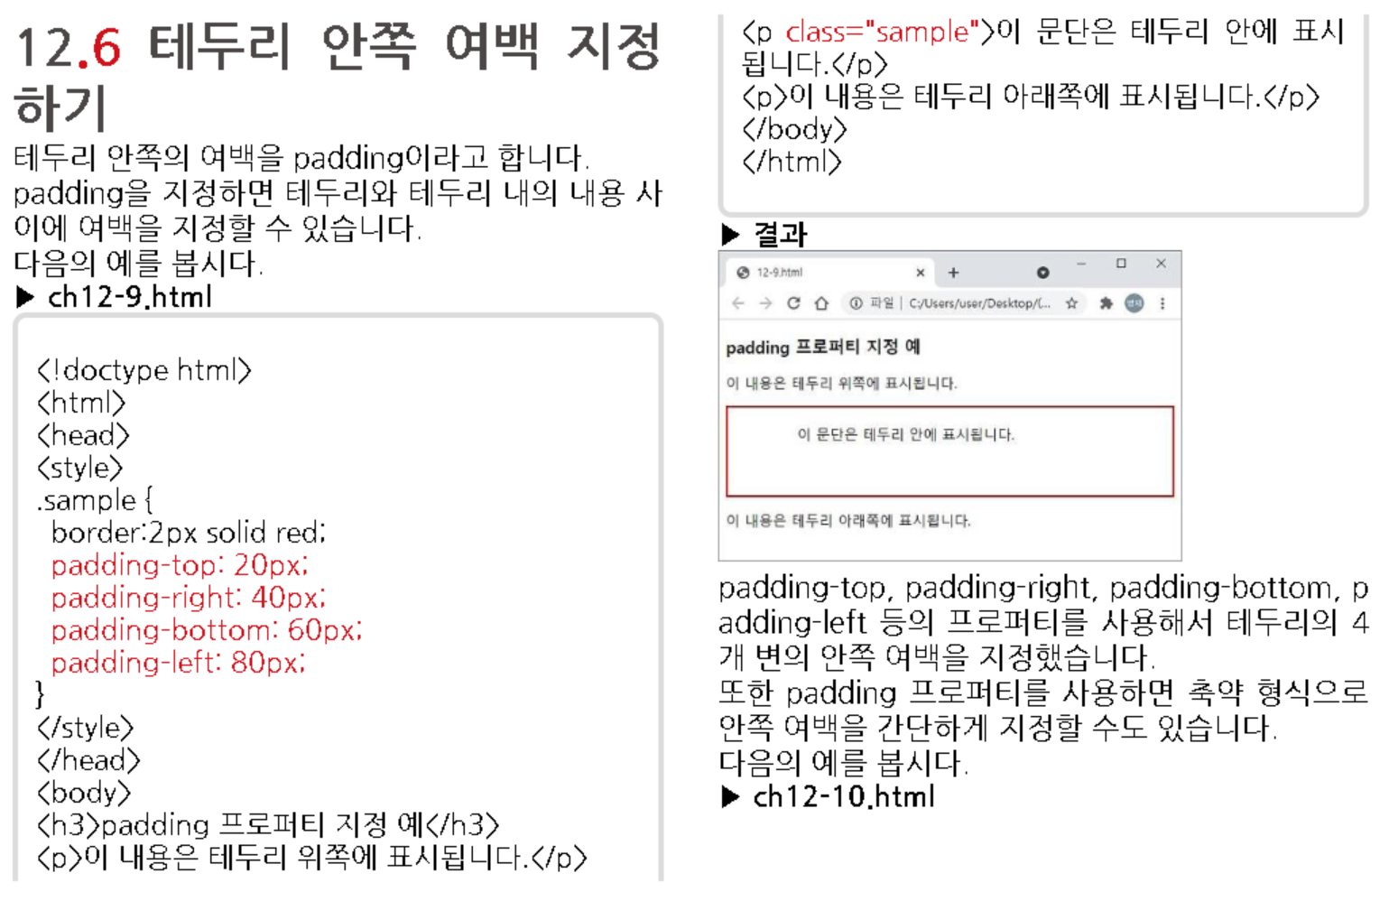

Slide 35
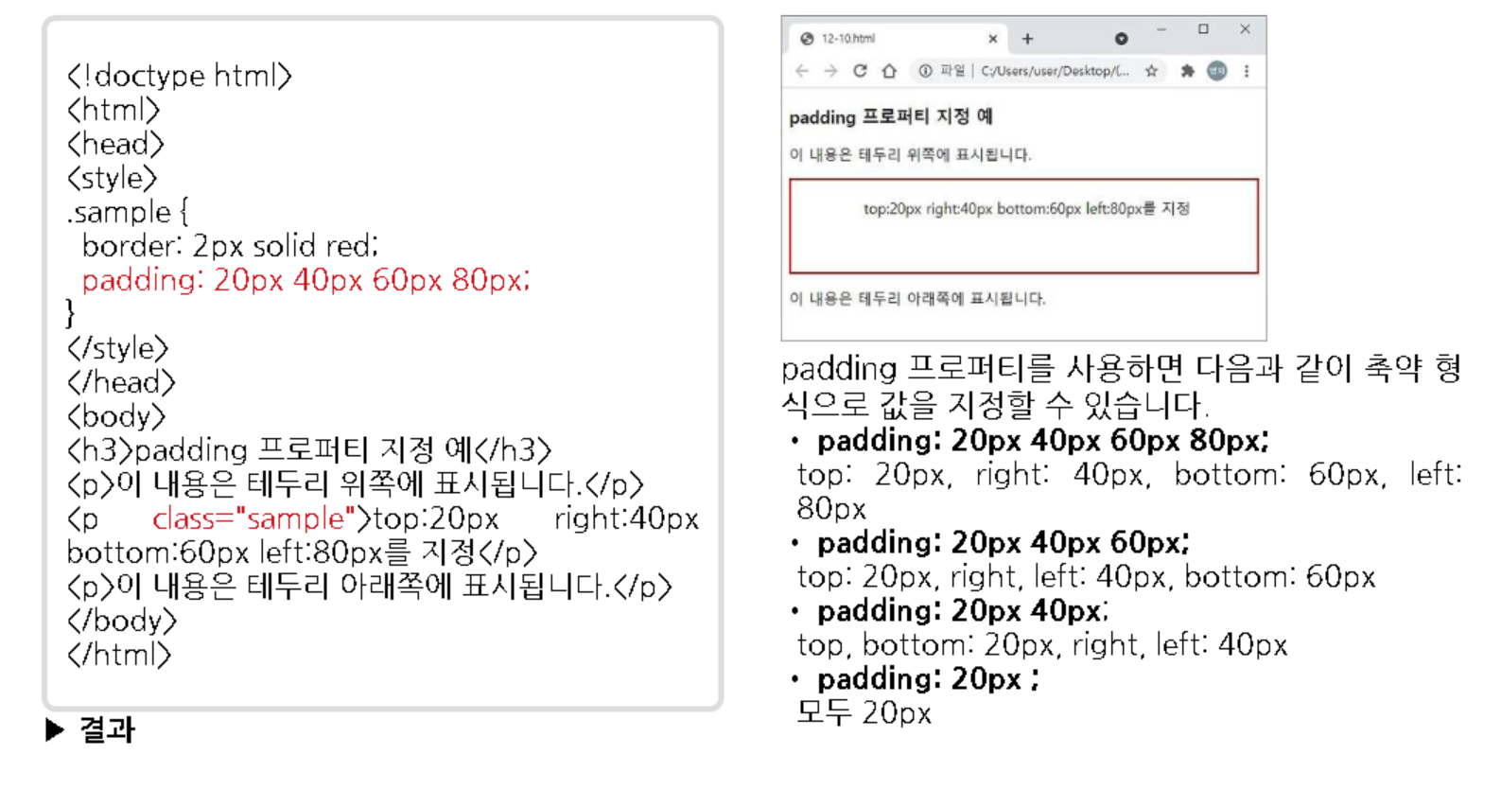

Slide 36
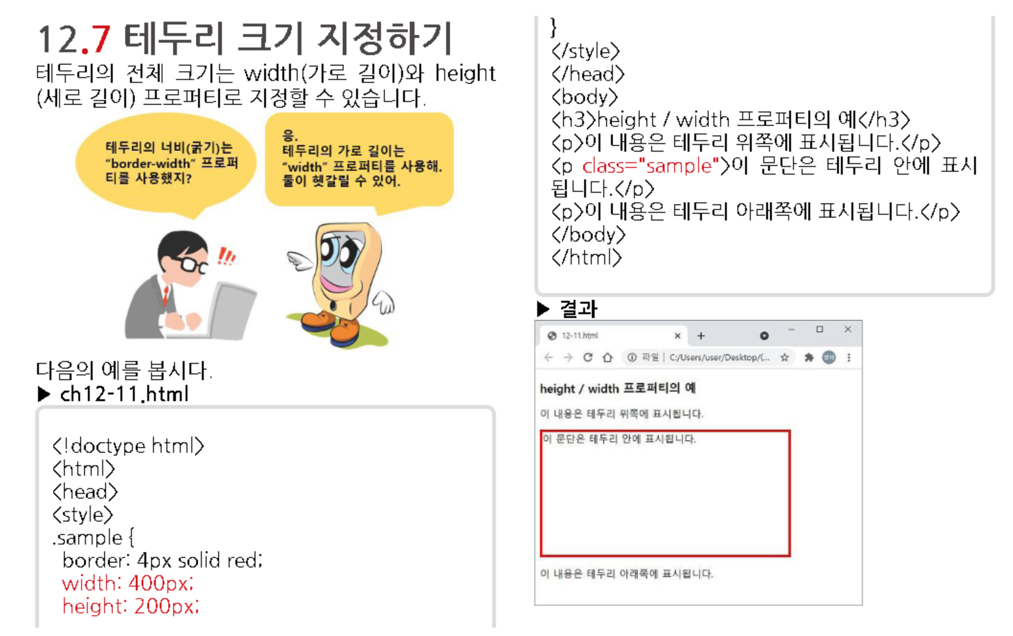

Slide 37
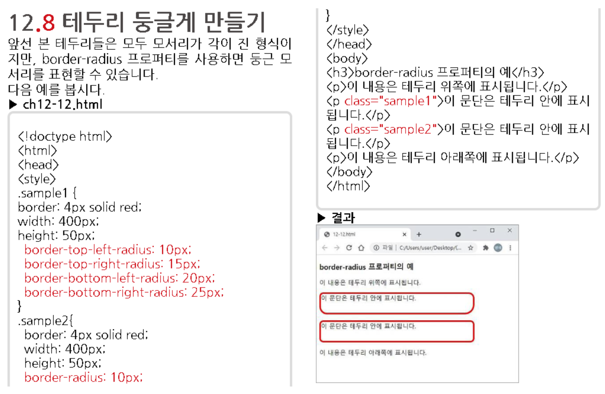

Slide 38
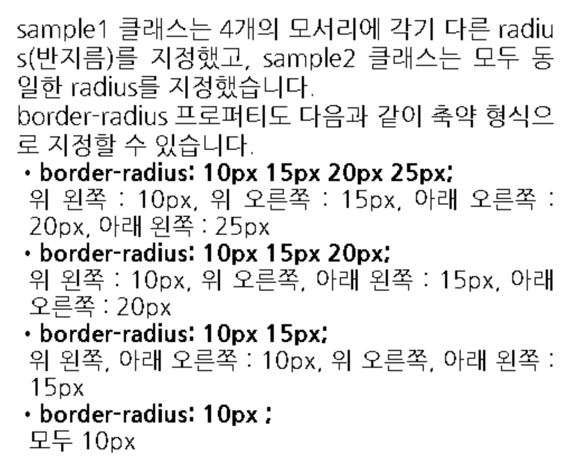

Slide 39
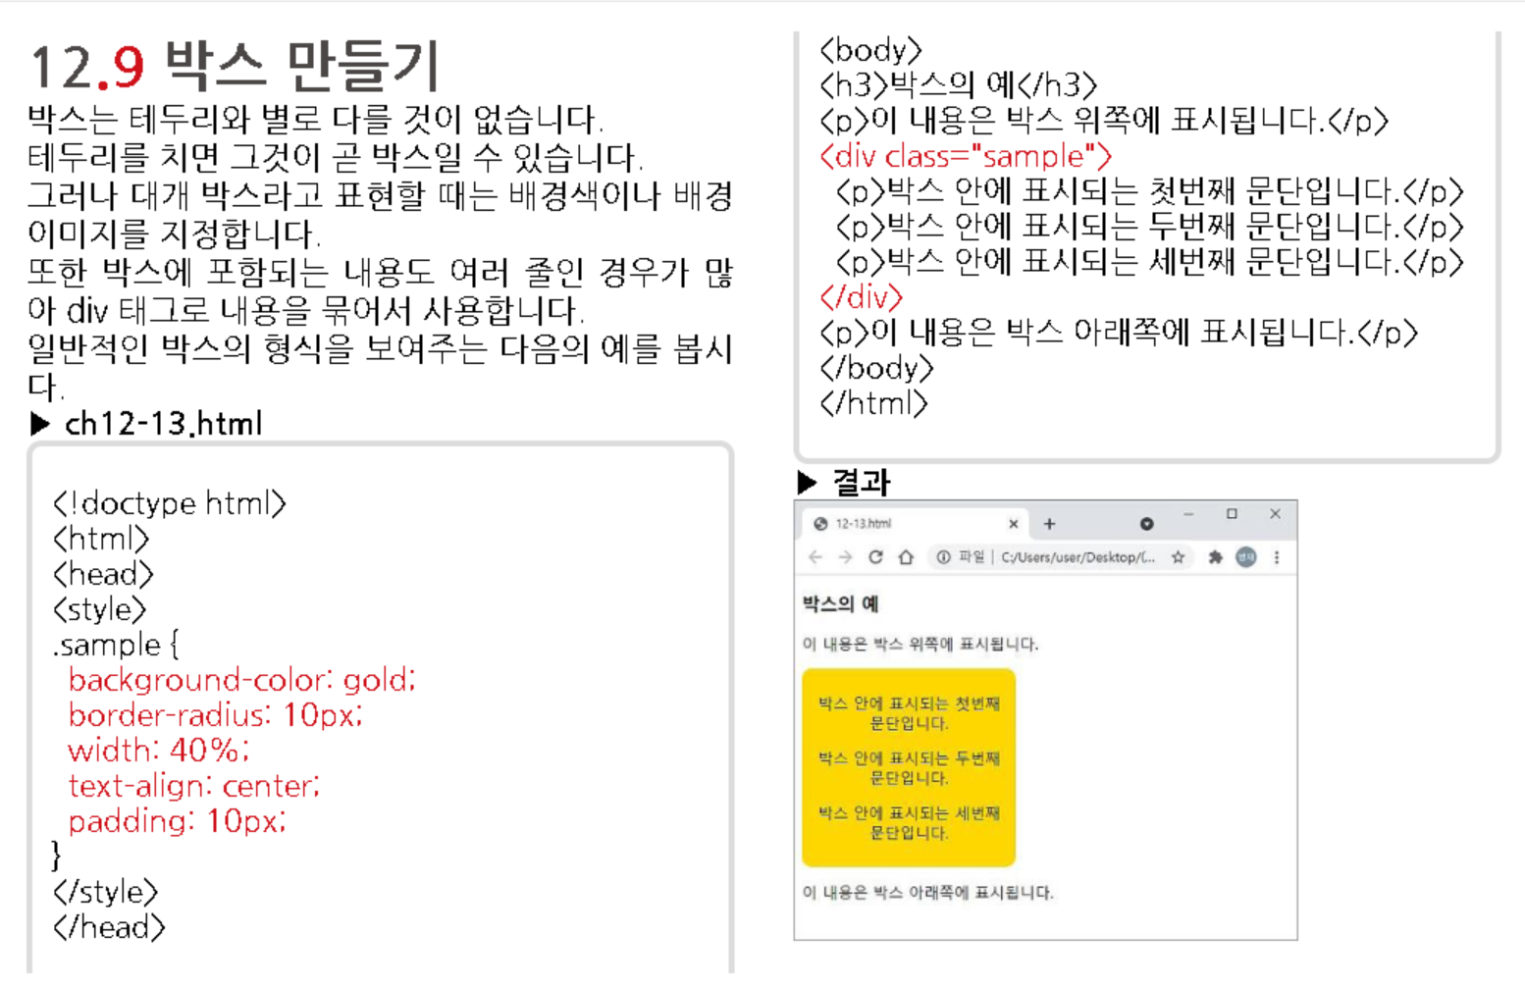
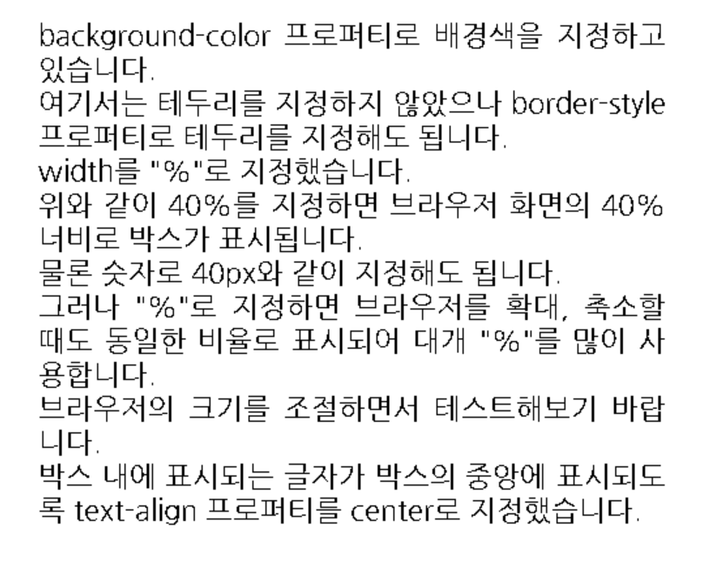

Slide 40
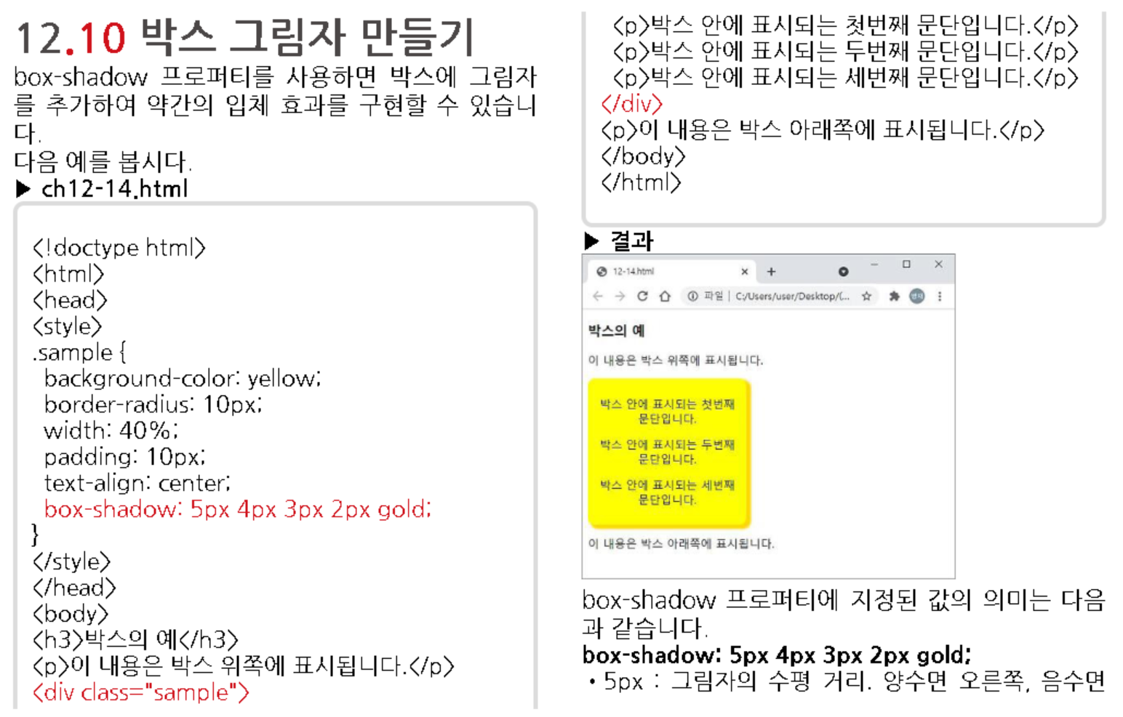

Slide 41
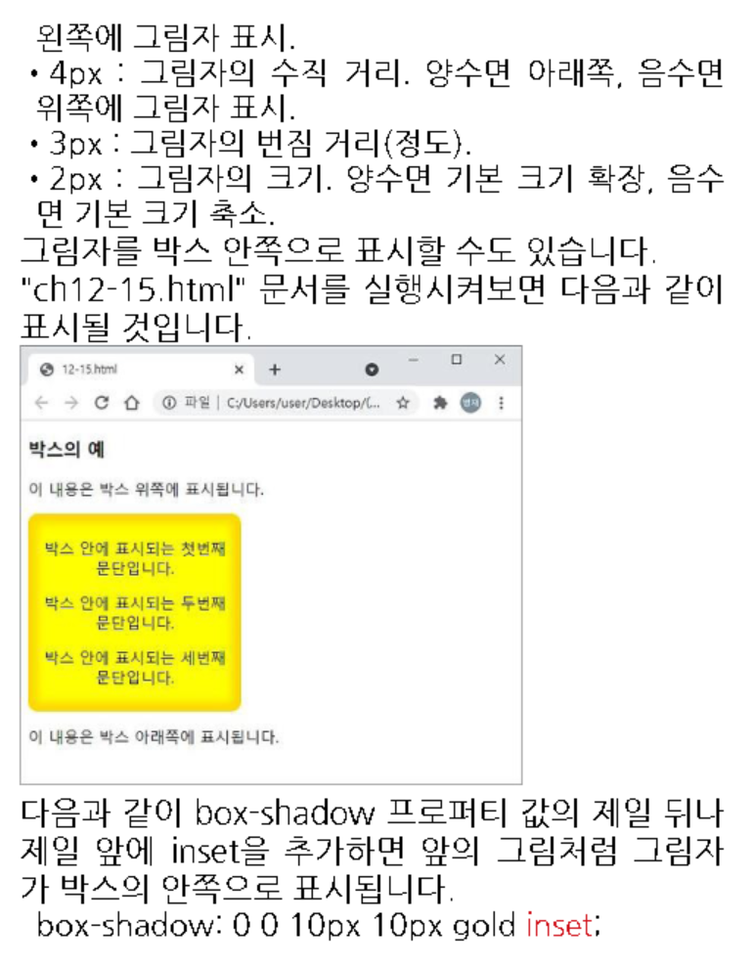

Slide 42
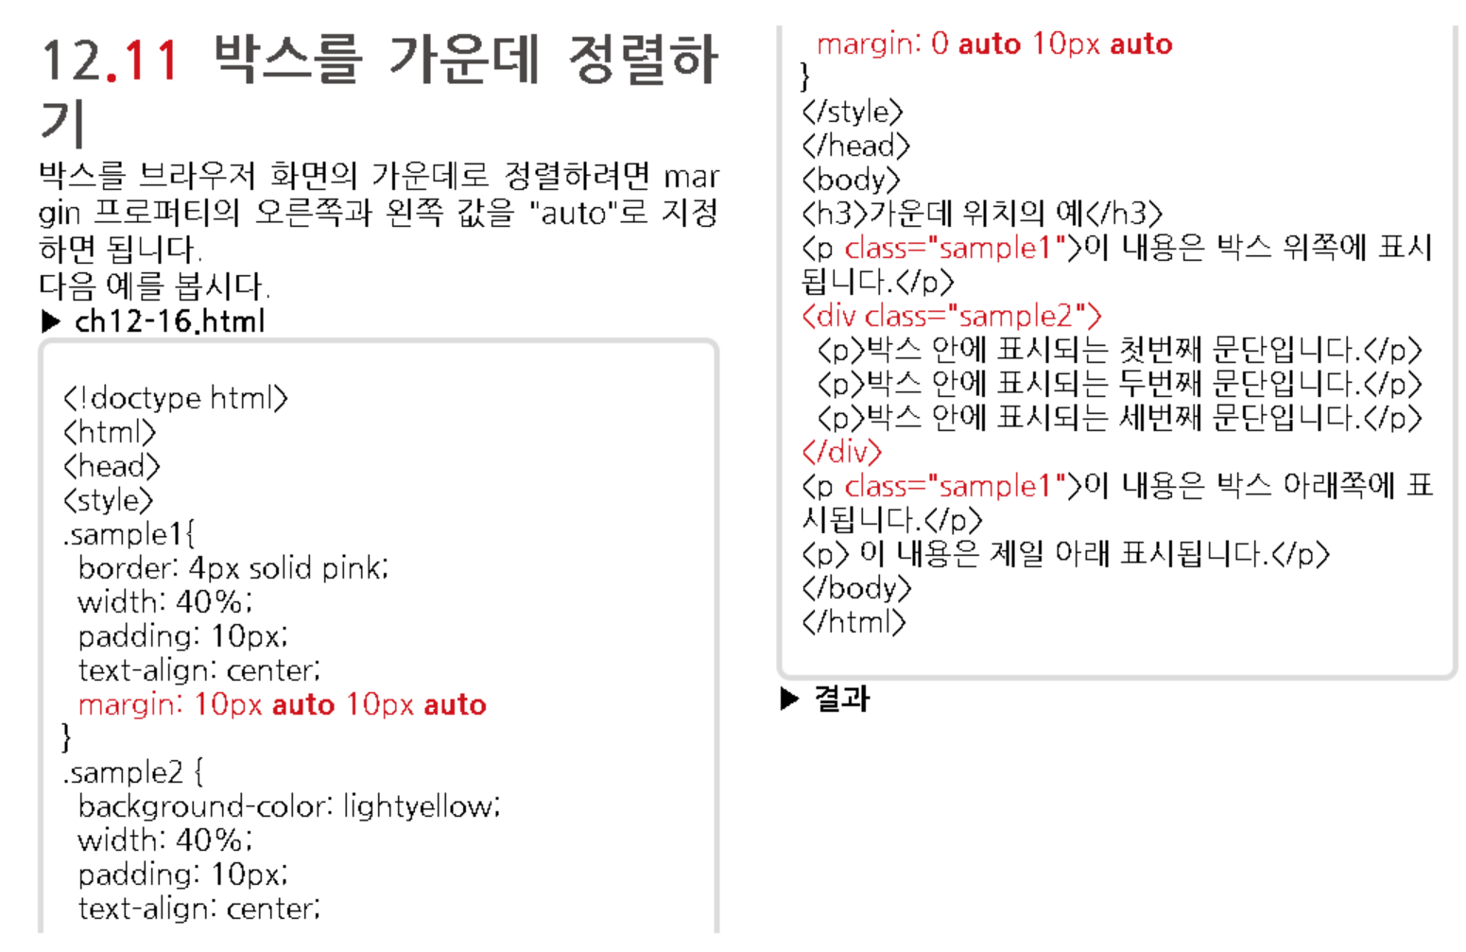
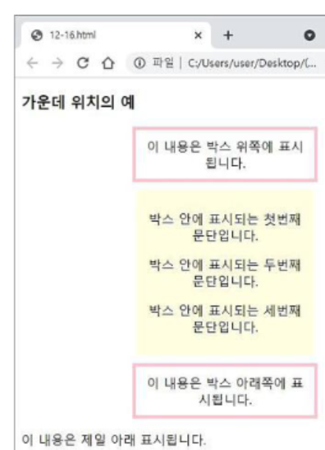

Slide 43
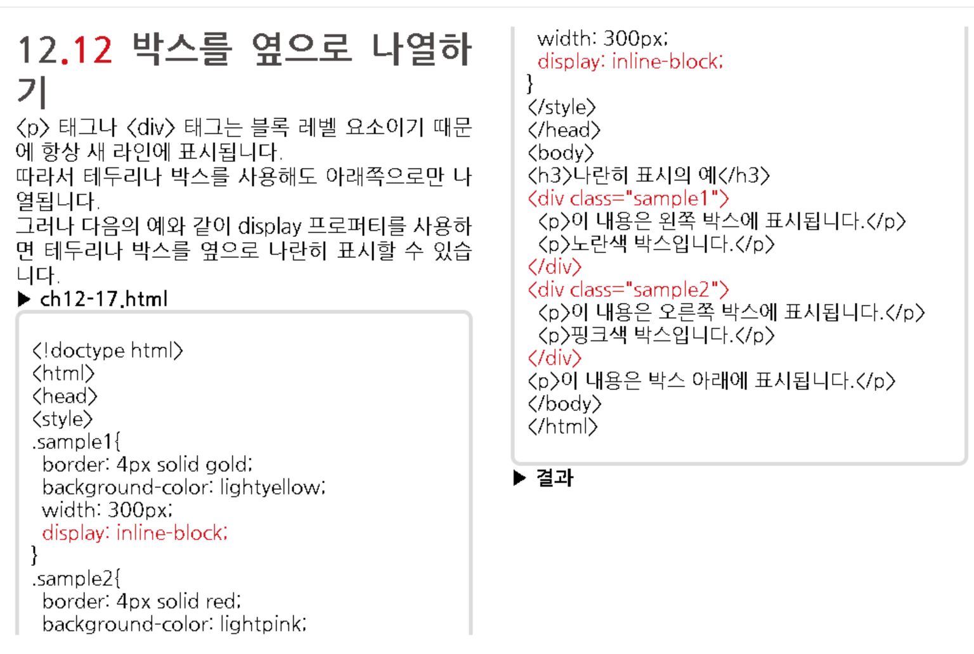

Slide 44
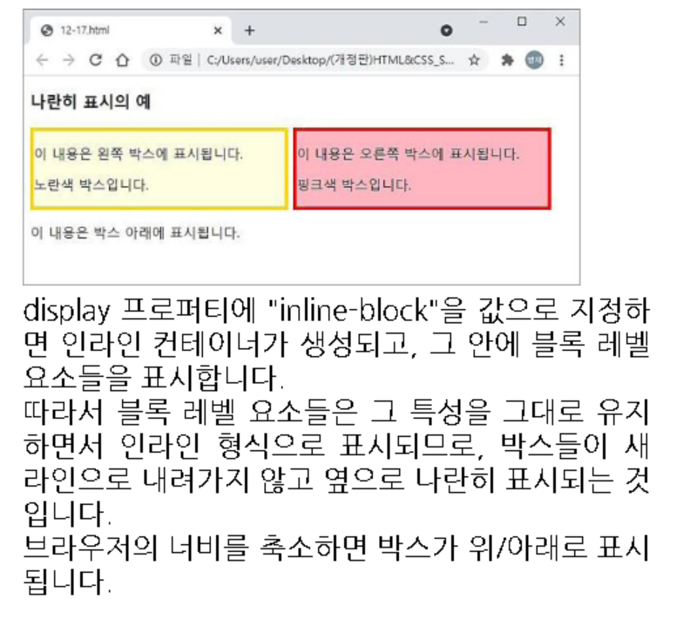

Slide 45
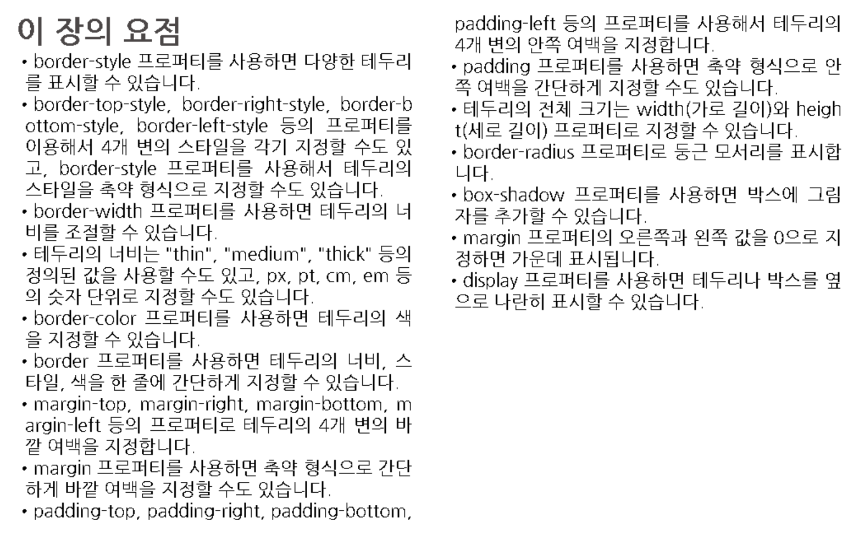

Slide 47
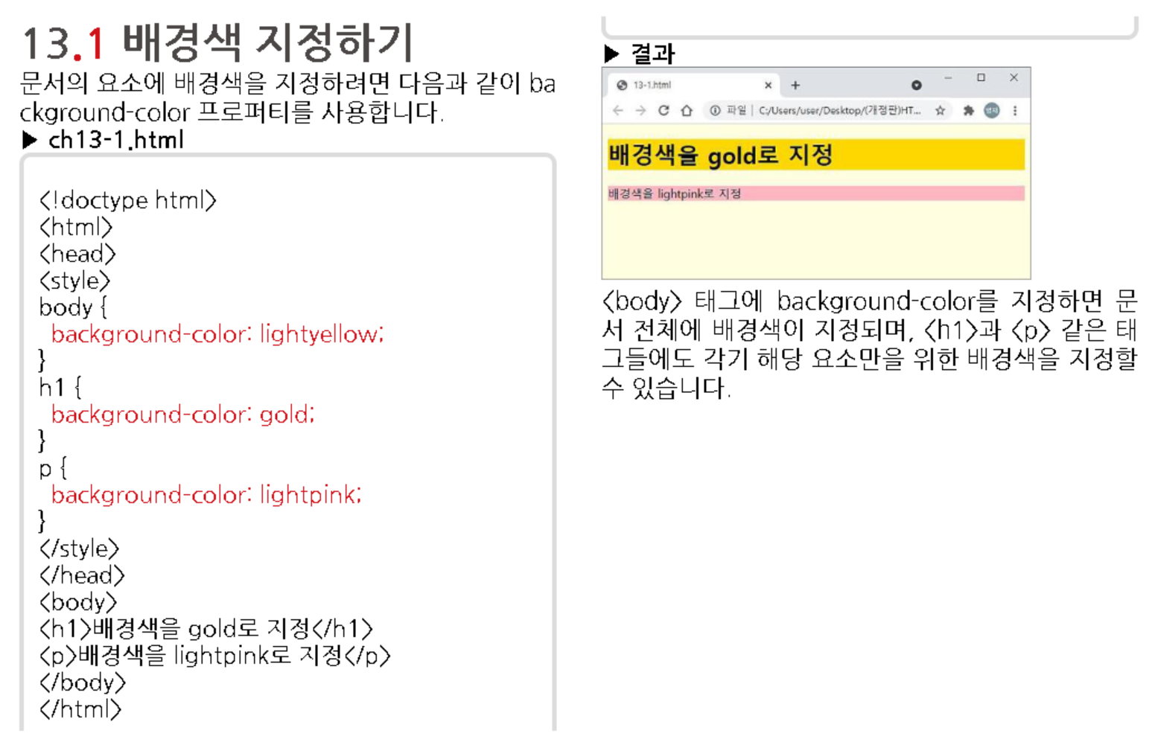

Slide 48
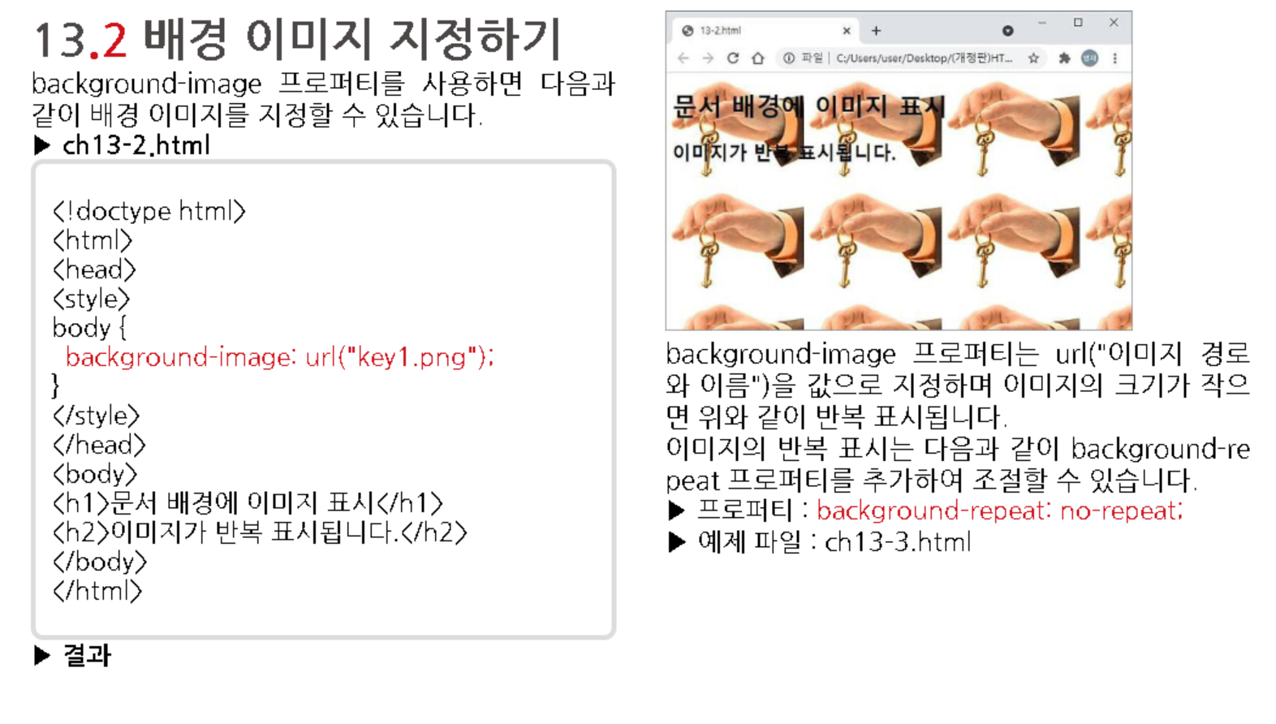

Slide 49
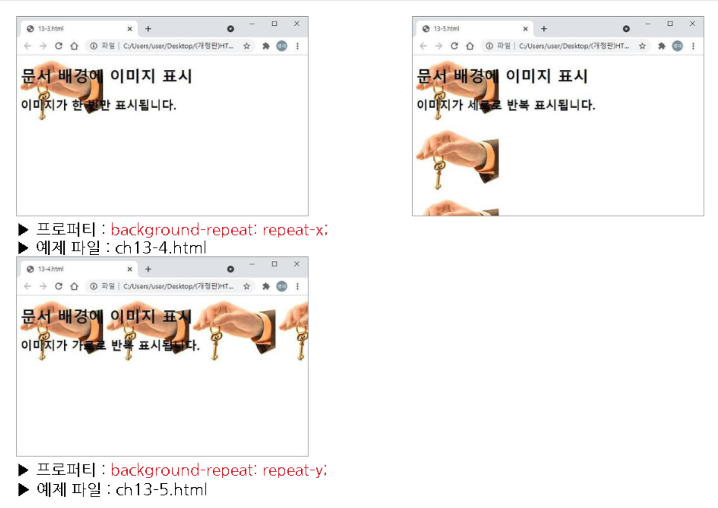

Slide 50
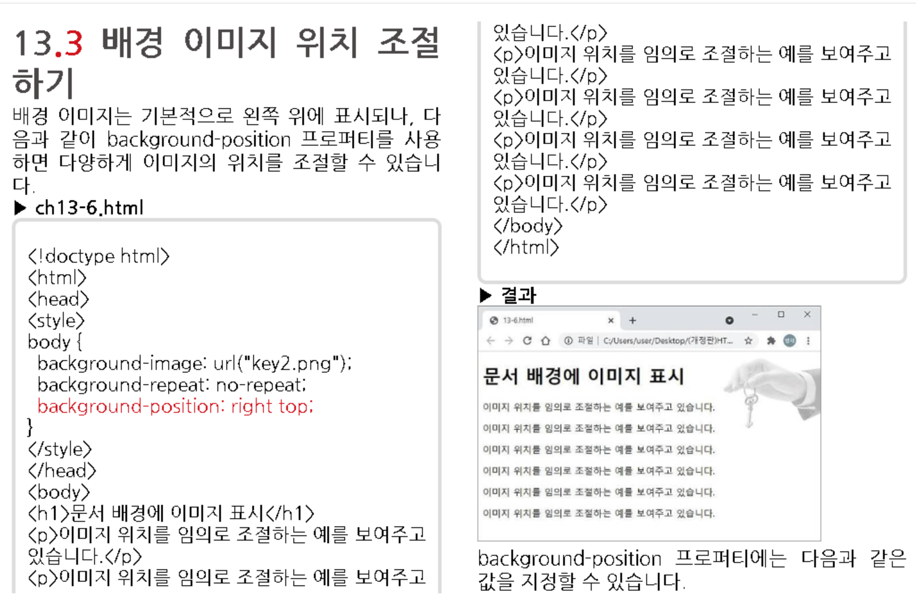

Slide 51
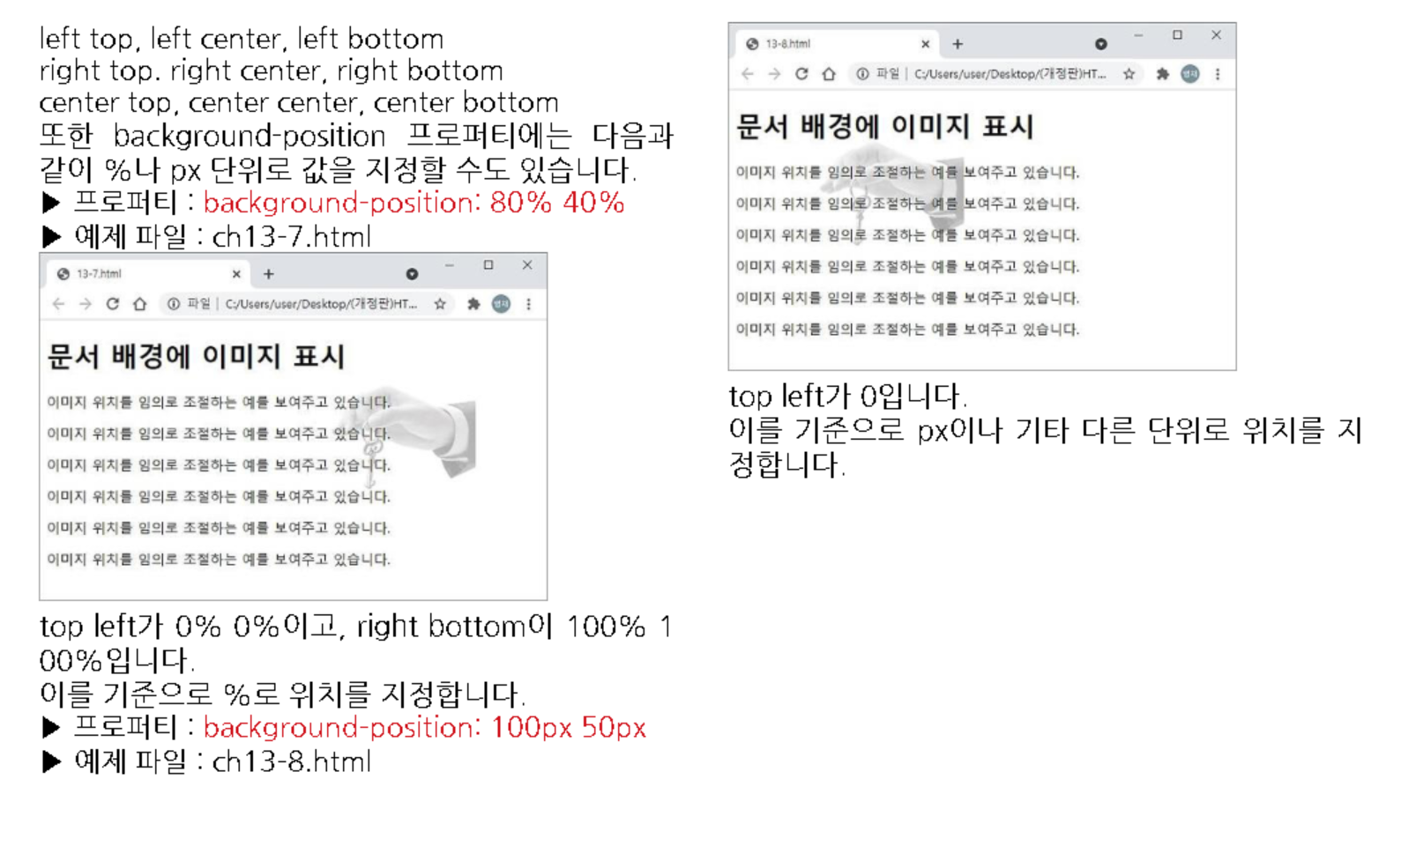

Slide 52



Slide 53



Slide 54


Slide 55


Slide 56



Slide 57


Slide 58



Slide 59


Slide 60


Slide 61


Slide 62



Slide 63


Slide 64



Slide 65


